Slide 1
Health inequalities briefing Sandwell
March 2018
Version 1.3 Released March 2018

Slide 2
What are health inequalities?
"Health inequalities are differences between people or groups due to social, geographical, biological or other factors. These differences have a huge impact, because they result in people who are worst off experiencing poorer health and shorter lives."
NICE
https://www.nice.org.uk/advice/lgb4/chapter/introduction
Health Inequalities in Sandwell Version 1.3 Released March 2018

Slide 3
About the briefing
l l l l l
The Global Burden of Disease (GBD) highlights the conditions causing the largest burden (in terms of disability-adjusted life years) in the West Midlands region The purpose of this briefing is to demonstrate inequalities in important high-burden diseases - defined either because they are high-burden as measured by the GBD, or because they are strongly associated with income deprivation locally (or both) This briefing also includes a number of indicators where there is a particularly strong statistical linear relationship with income deprivation at ward level It uses routinely available data from the Local Health website This briefing uses 2016 ward boundaries and income deprivation data for 2015
(www.localhealth.org.uk, downloaded November 2017)
Health Inequalities in Sandwell Version 1.3 Released March 2018
Notes:
This briefing slide set has been produced by PHE's Knowledge & Intelligence Service. You may re-use the information (not including logos) free of charge in any format or medium, under the terms of the Open Government Licence. To view this licence, visit www.nationalarchives.gov.uk/doc/open-government-licence/version/3/

Slide 4
Glossary of Technical Terms Used
R-Squared
This is a statistical term which describes how close the data are to a line-of-best-fit. It ranges from 0 (not very good) to 1 (perfect).
Note: In the real world, a value of 1 is extremely unlikely!
Weighted Mean
This is an average that has been adjusted so that wards with larger populations have a greater effect on it.
Linear Regression Model
This is a technical term for a line-of-best-fit. As with the weighted mean, all of the regression models are weighted by ward population size.
Health Inequalities in Sandwell Version 1.3 Released March 2018
Notes:
Please note that we have tried to keep this slide-set in a format which allows it to be accessible to a lay audience. However, we understand that some users will appreciate a more technical explanation and it is hoped that this glossary provides that.

Slide 5
Glossary of Technical Terms Used
Standardised Mortality Ratio (SMR)
SMR = Observed/Expected x 100 A SMR is the ratio of the observed number of deaths in a ward to the number expected if the ward had the same age-specific rates as England.
Standardised Admission Ratio (SAR)
SAR = Observed/Expected x 100 A SAR is the ratio of the observed number of Admissions in a ward to the number expected if the ward had the same age-specific rates as England.
Standardised Incidence Ratio (SIR)
SIR = Observed/Expected x 100 A SIR is the ratio of the observed number of Incidences in a ward to the number expected if the ward had the same age-specific rates as England.
Health Inequalities in Sandwell Version 1.3 Released March 2018

Slide 6
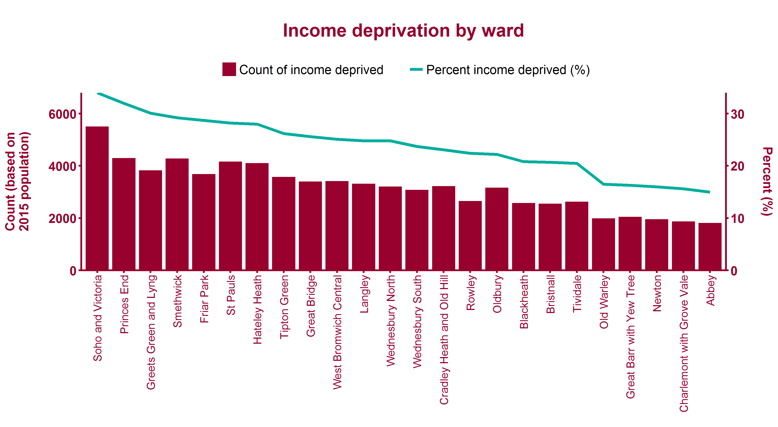
Distribution of income deprivation across Sandwell
Health Inequalities in Sandwell Version 1.3 Released March 2018
Notes:
Indices of Multiple Deprivation 2015 - Income Deprivation Score by ward. Estimated count calculated by applying rate to 2015 population. Metadata: See Local Health.

Slide 7
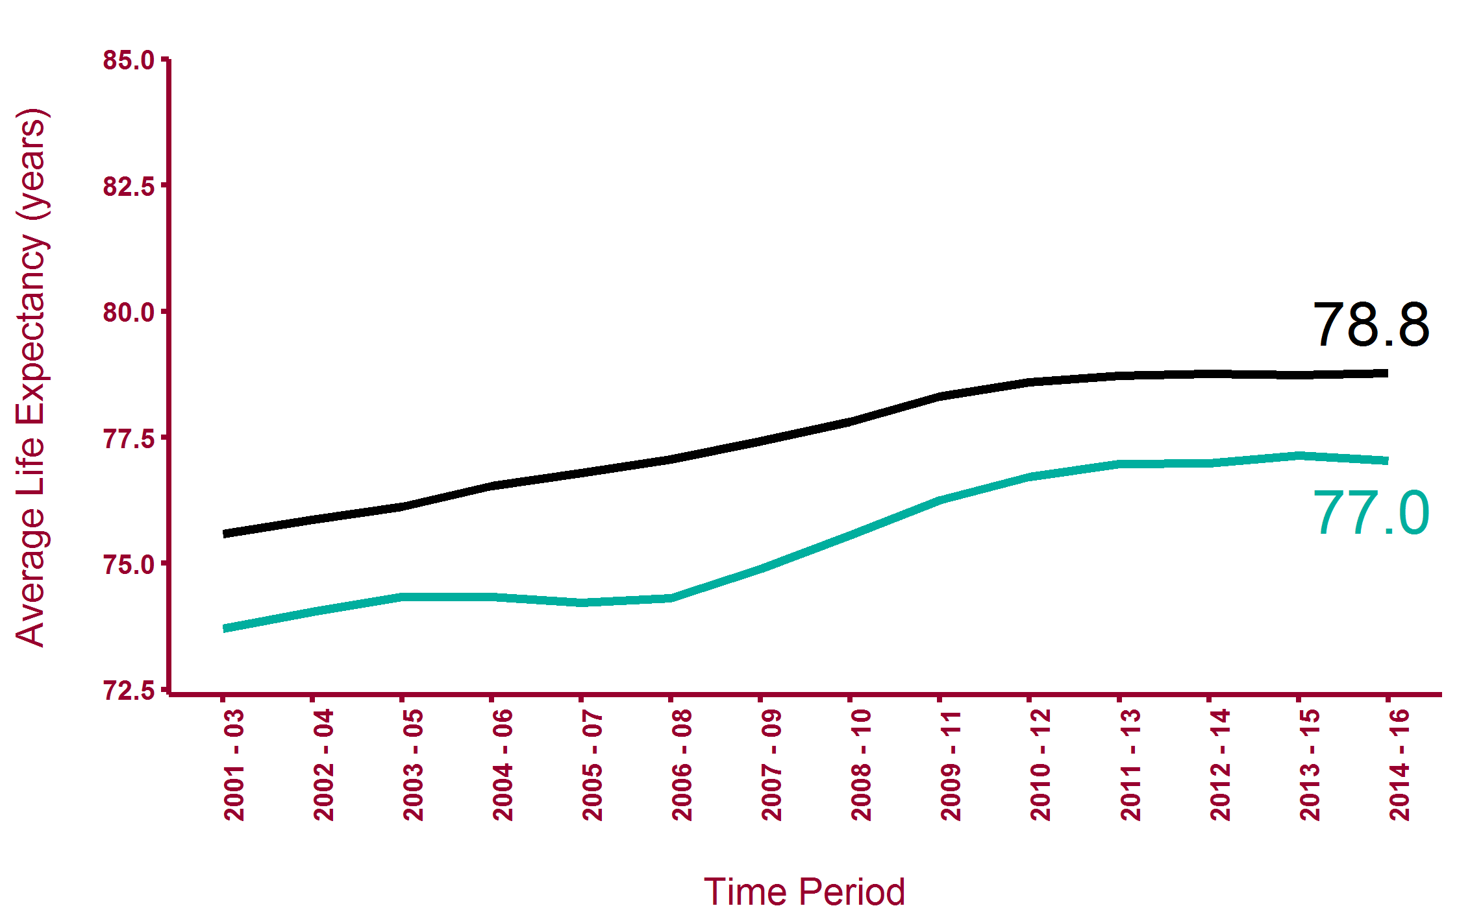
Life expectancy at birth (male)
West Midlands
Sandwell
Health Inequalities in Sandwell Version 1.3 Released March 2018
Health Inequalities in Sandwell Version 1.3 Released March 2018
Notes:
Public Health England Outcome Indicator 0.1ii - Life Expectancy at birth (Males) Local and regional average www.phoutcomes.info

Slide 8
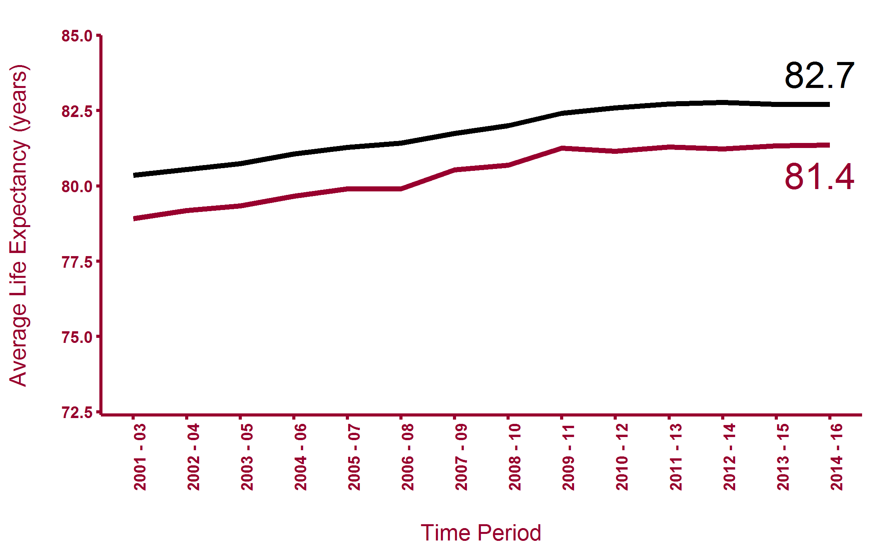
Life expectancy at birth (female)
West Midlands
Sandwell
Health Inequalities in Sandwell Version 1.3 Released March 2018
Health Inequalities in Sandwell Version 1.3 Released March 2018
Notes:
Public Health England Outcome Indicator 0.1ii - Life Expectancy at birth (Females) Local and regional average www.phoutcomes.info

Slide 9
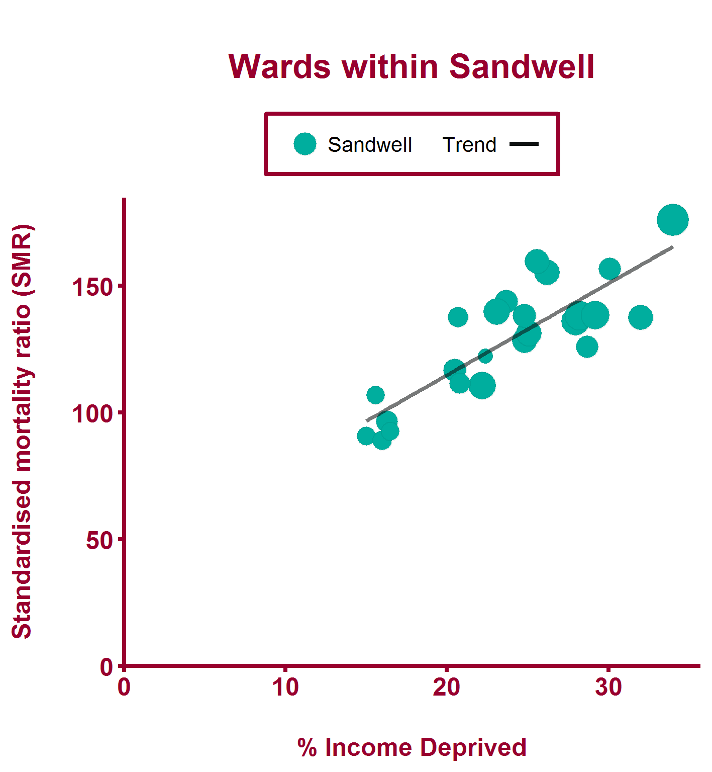
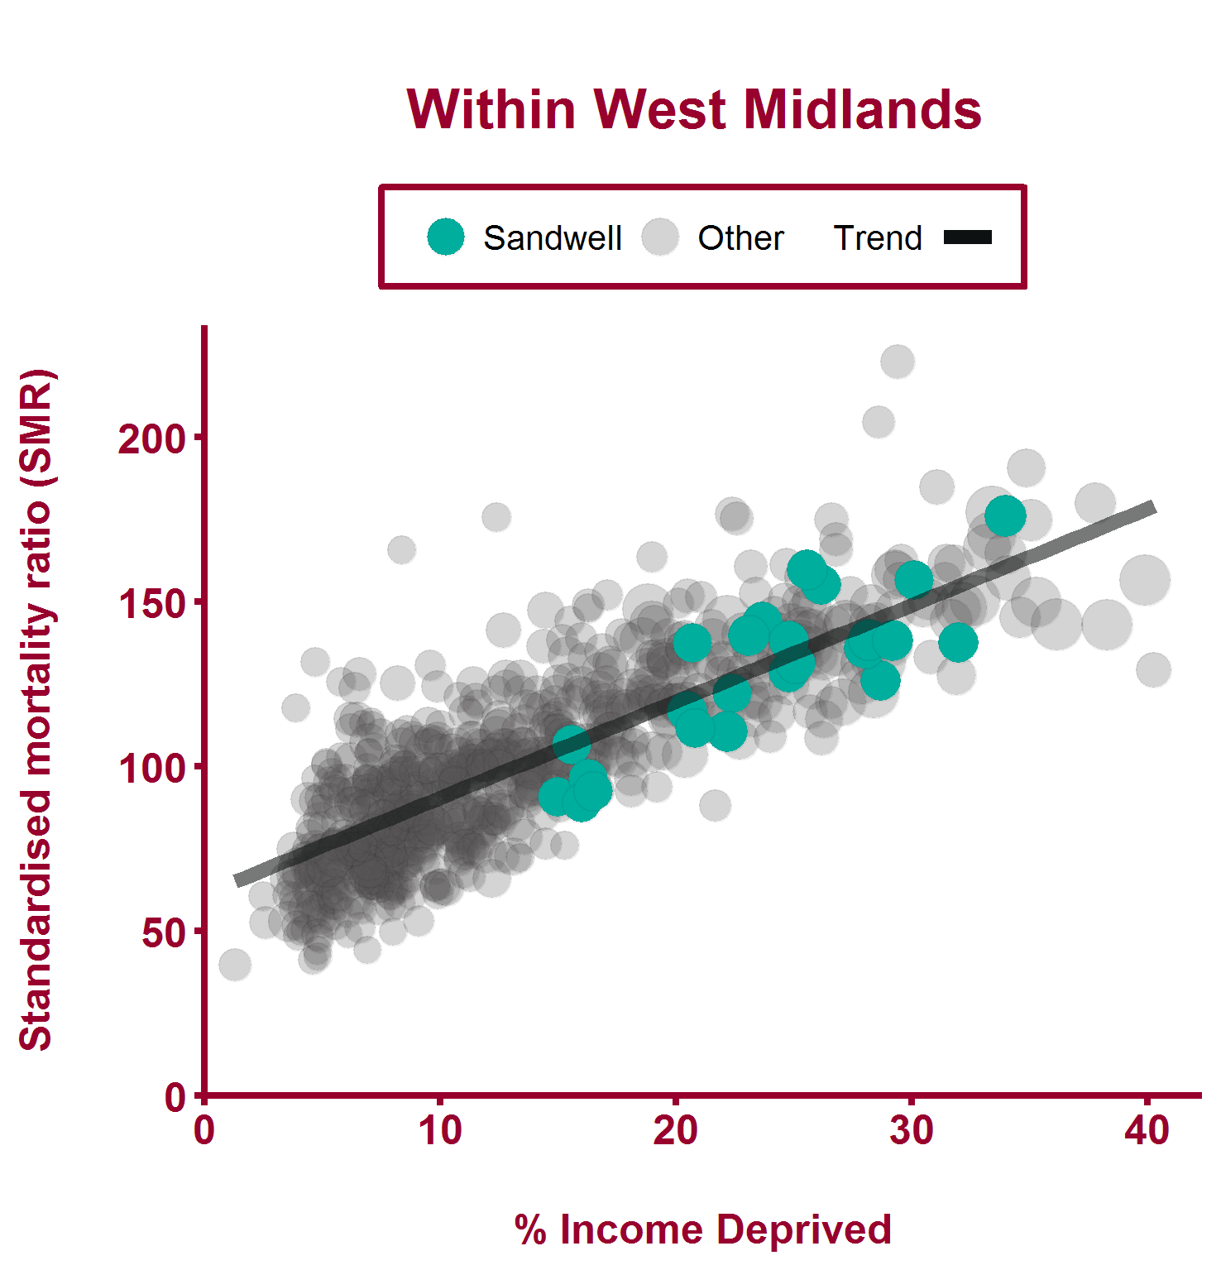
Premature mortality for Sandwell wards by % income deprived
Deaths from all causes, under 75 years (2011-2015)
Health Inequalities in Sandwell Version 1.3 Released March 2018
Notes:
Note a different scale is used for local data compared to regional data Metadata: See Local Health. Included in download spreadsheet.

Slide 10
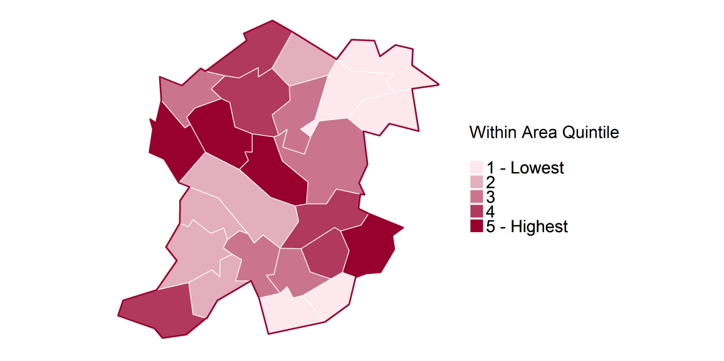
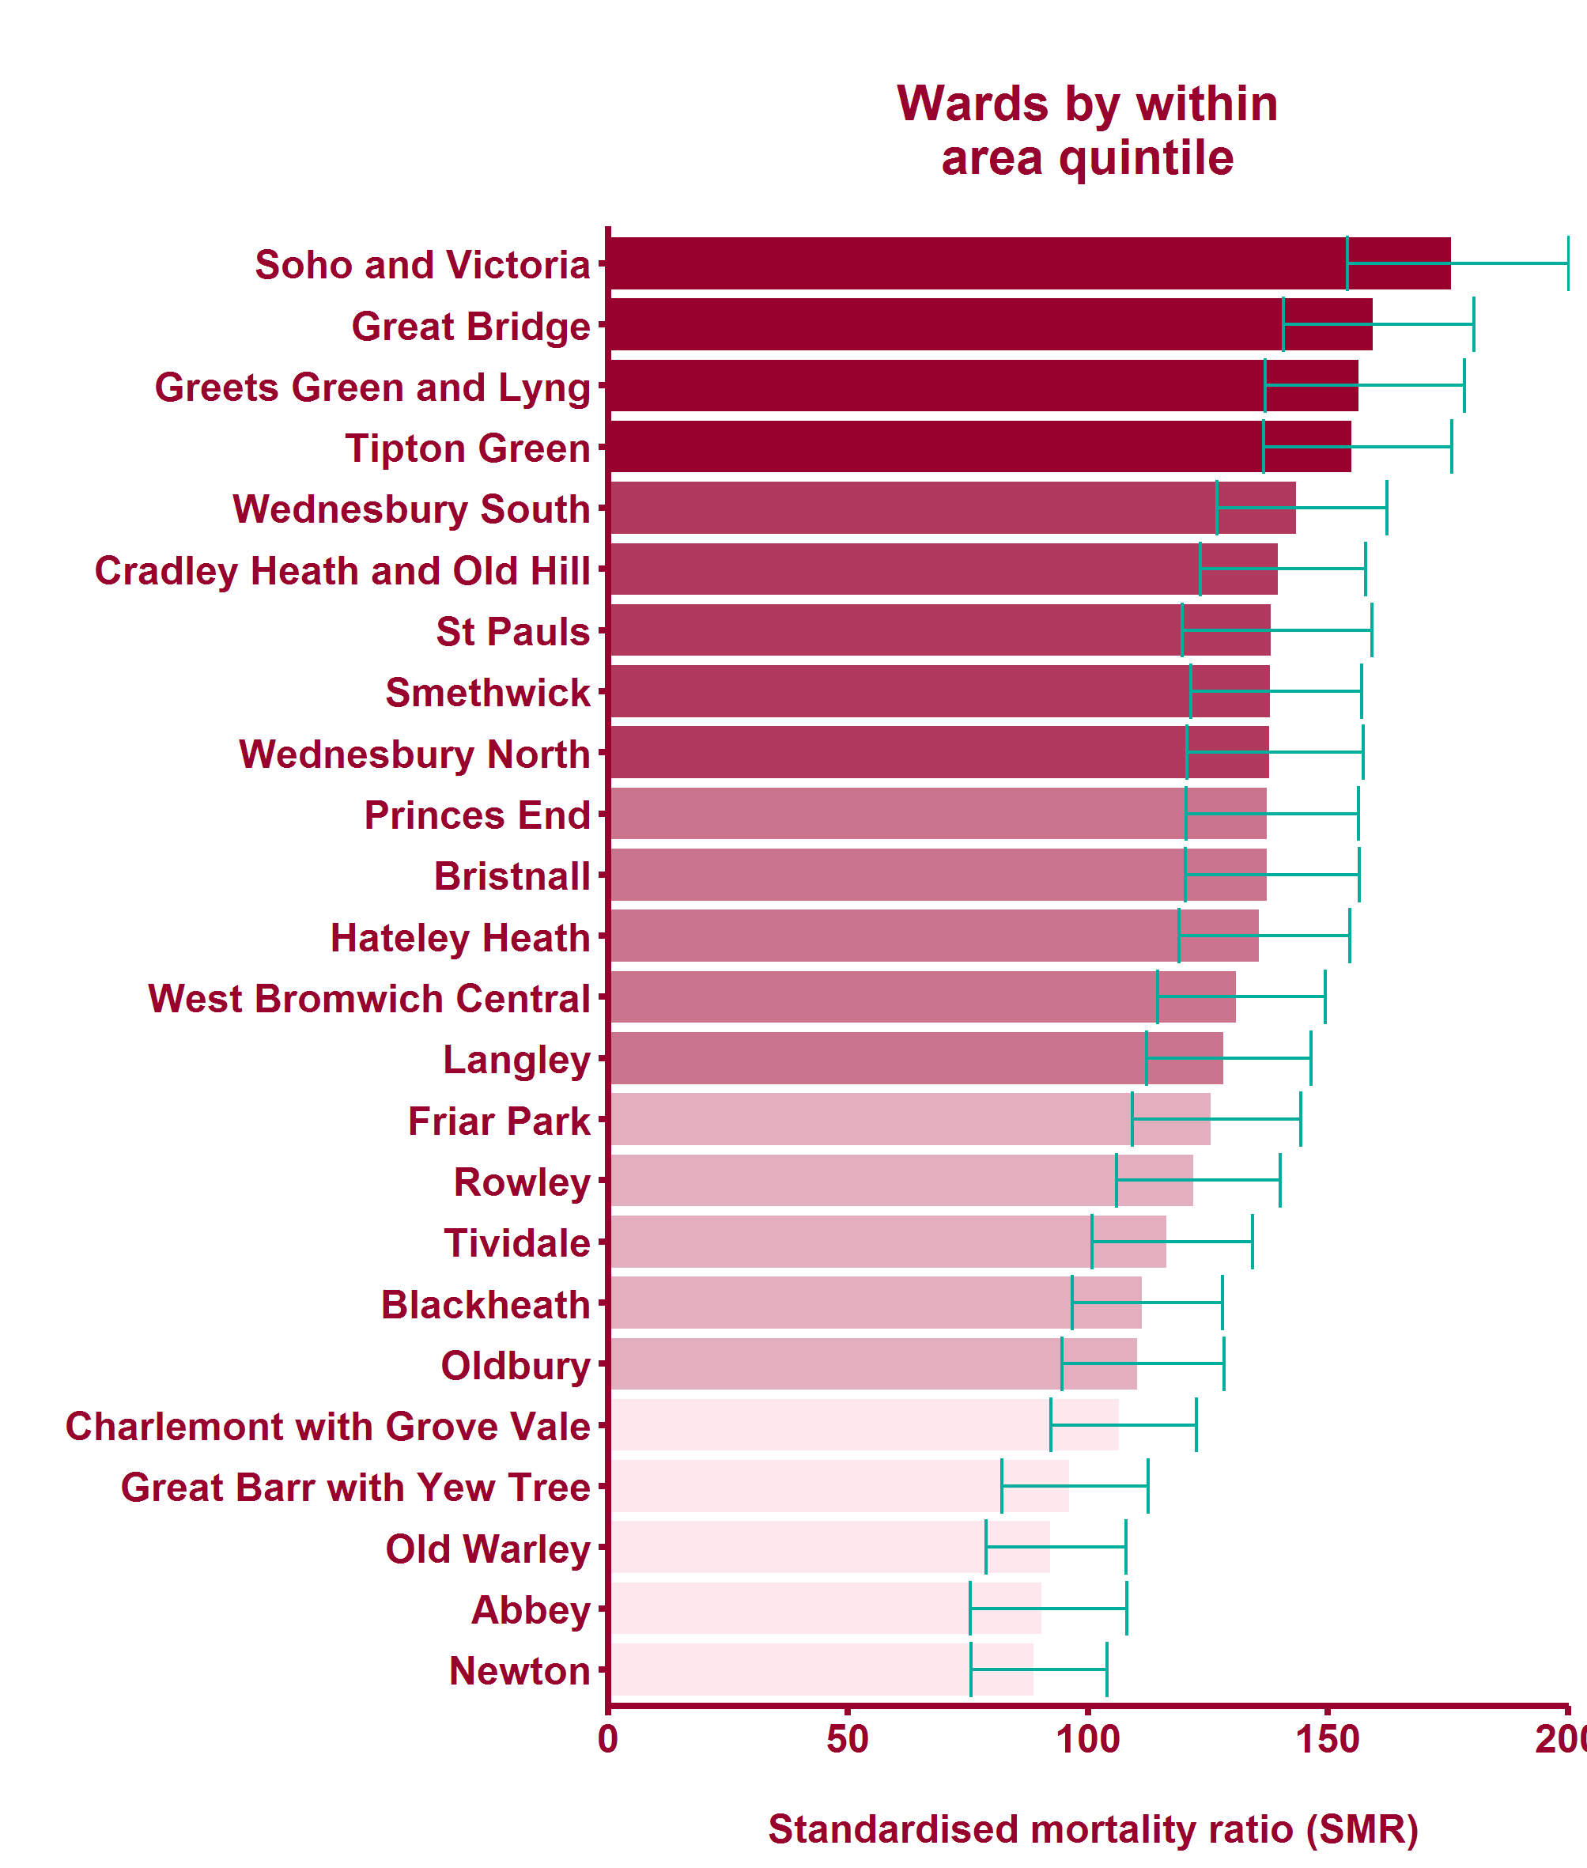
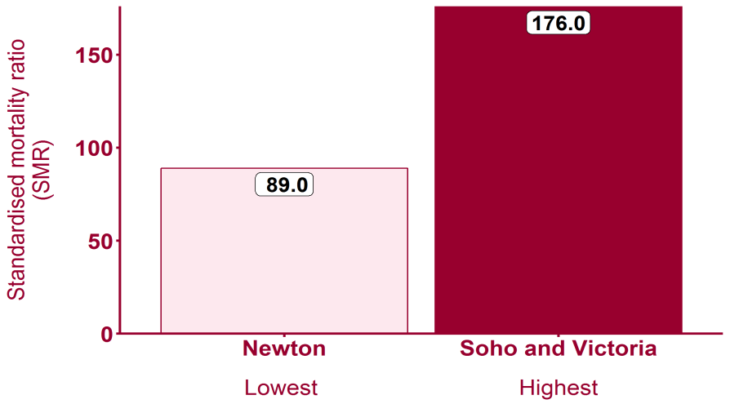
Deaths from all causes, under 75 years (2011-2015)
Health Inequalities in Sandwell Version 1.3 Released March 2018

Slide 11
GBD cause: West Midlands
Causes ranked by percentage of total disability-adjusted life years
Health Inequalities in Sandwell Version 1.3 Released March 2018
Notes:
Global Burden of Disease (GBD) is a tool to quantify health loss from hundreds of diseases, injuries, and risk factors, so that health systems can be improved and disparities can be eliminated. See http://www.healthdata.org/gbd/about. The slide lists the top 8 conditions in the region as measured by disability-adjusted life years. See http://www.healthdata.org/gbd/data-visualizations.

Slide 12
Global Burden of Disease: Low back and neck pain
Health Inequalities in Sandwell Version 1.3 Released March 2018

Slide 13
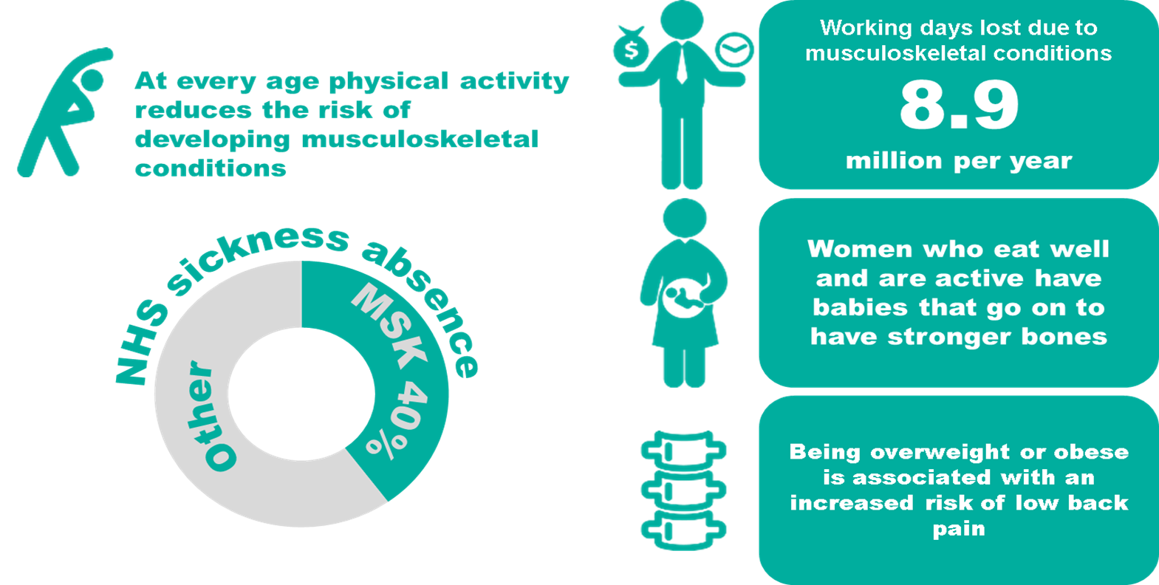
Low back and neck pain - National picture
Health Inequalities in Sandwell Version 1.3 Released March 2018
Notes:
Note: the following slides use the closest currently available local health indicator - limiting long term illness or disability Source: Health & Safety Executive http://www.hse.gov.uk/statistics/causdis/musculoskeletal/msd.pdf Data Source: Labour Force Survey The association between obesity & low back pain: A meta-analysis Rahman et al, 2010, http://aje.oxfordjournals.org/content/171/2/135.full

Slide 14
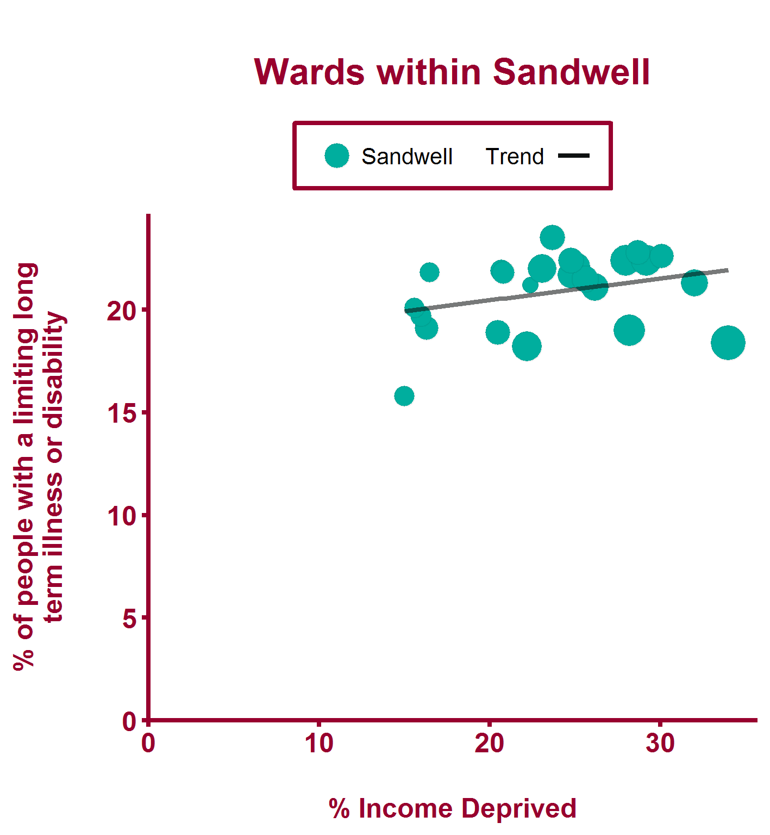
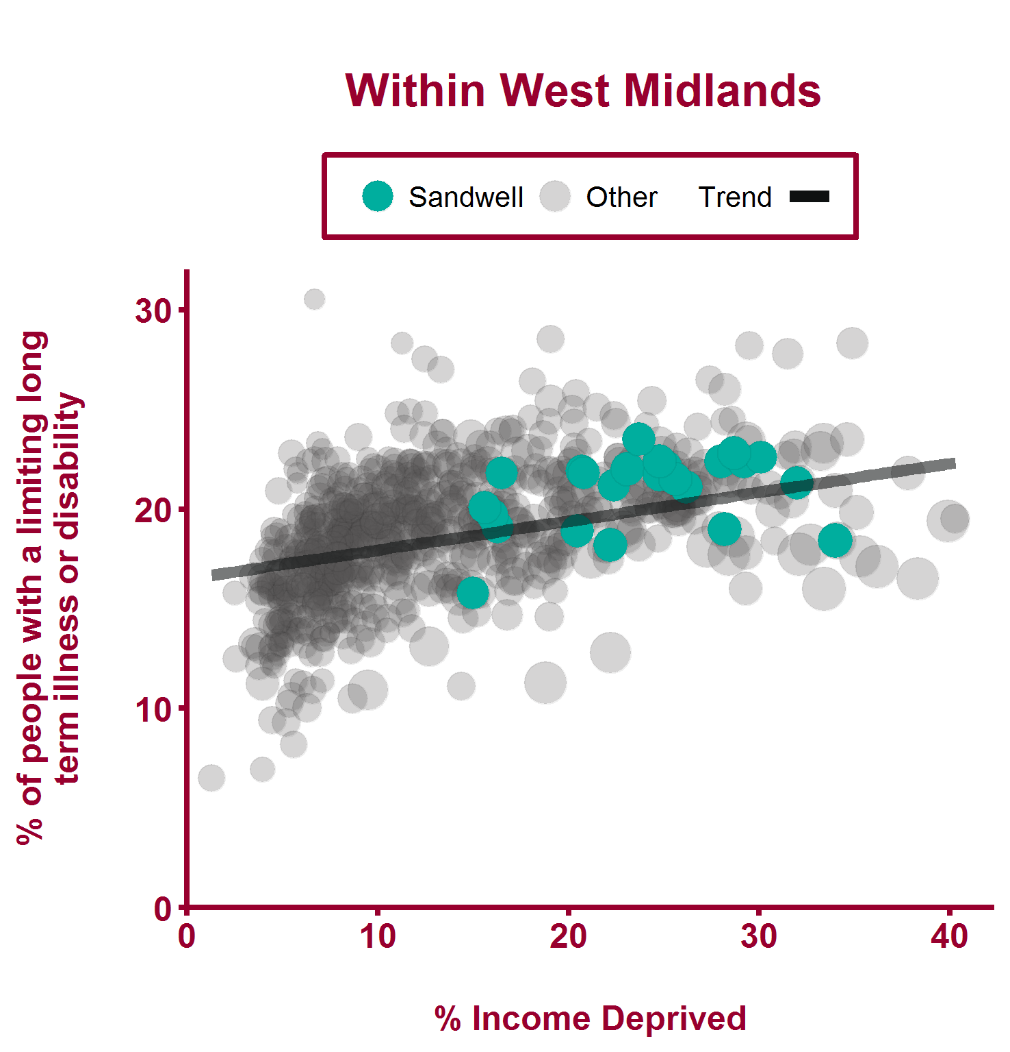
Limiting long term illness or disability (2011)
Health Inequalities in Sandwell Version 1.3 Released March 2018

Slide 15
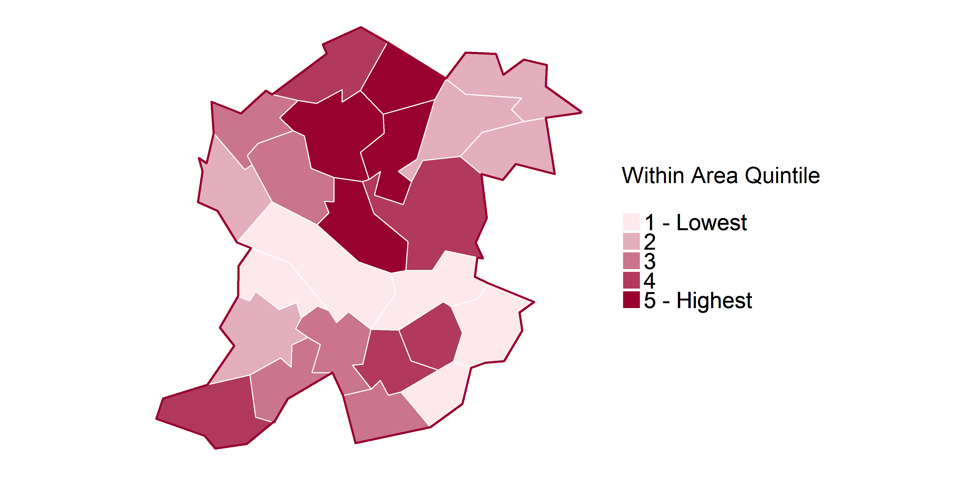
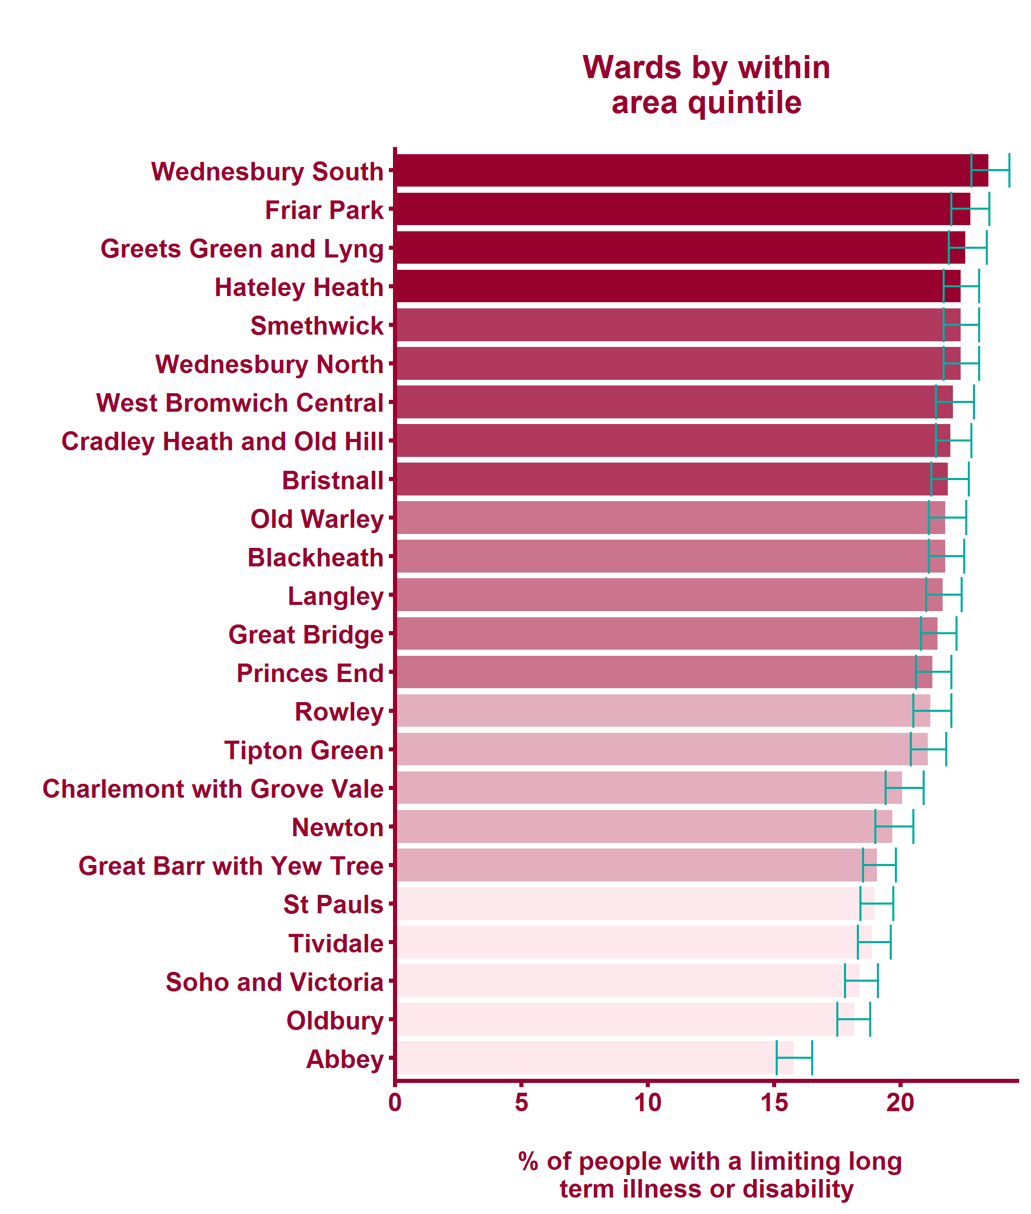
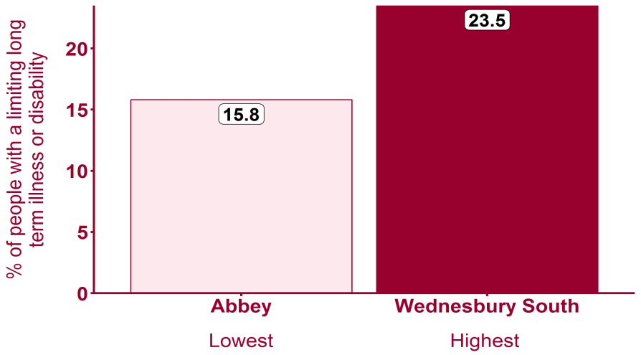
Limiting long term illness or disability (2011)
Health Inequalities in Sandwell Version 1.3 Released March 2018

Slide 16
Global Burden of Disease: Ischaemic heart disease
Health Inequalities in Sandwell Version 1.3 Released March 2018

Slide 17
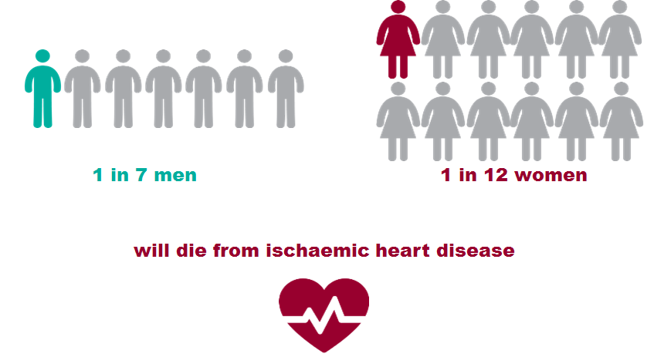
Ischaemic heart disease - National picture
Health Inequalities in Sandwell Version 1.3 Released March 2018
Notes:
Of the 490,791 deaths in England in 2016, 13.6% male deaths and 8.3% female deaths had an underlying cause of death recorded as Ischaemic heart disease (ICD10 I20-I25) in 2016 Source: ONS Annual Death registration extracts, 2016

Slide 18
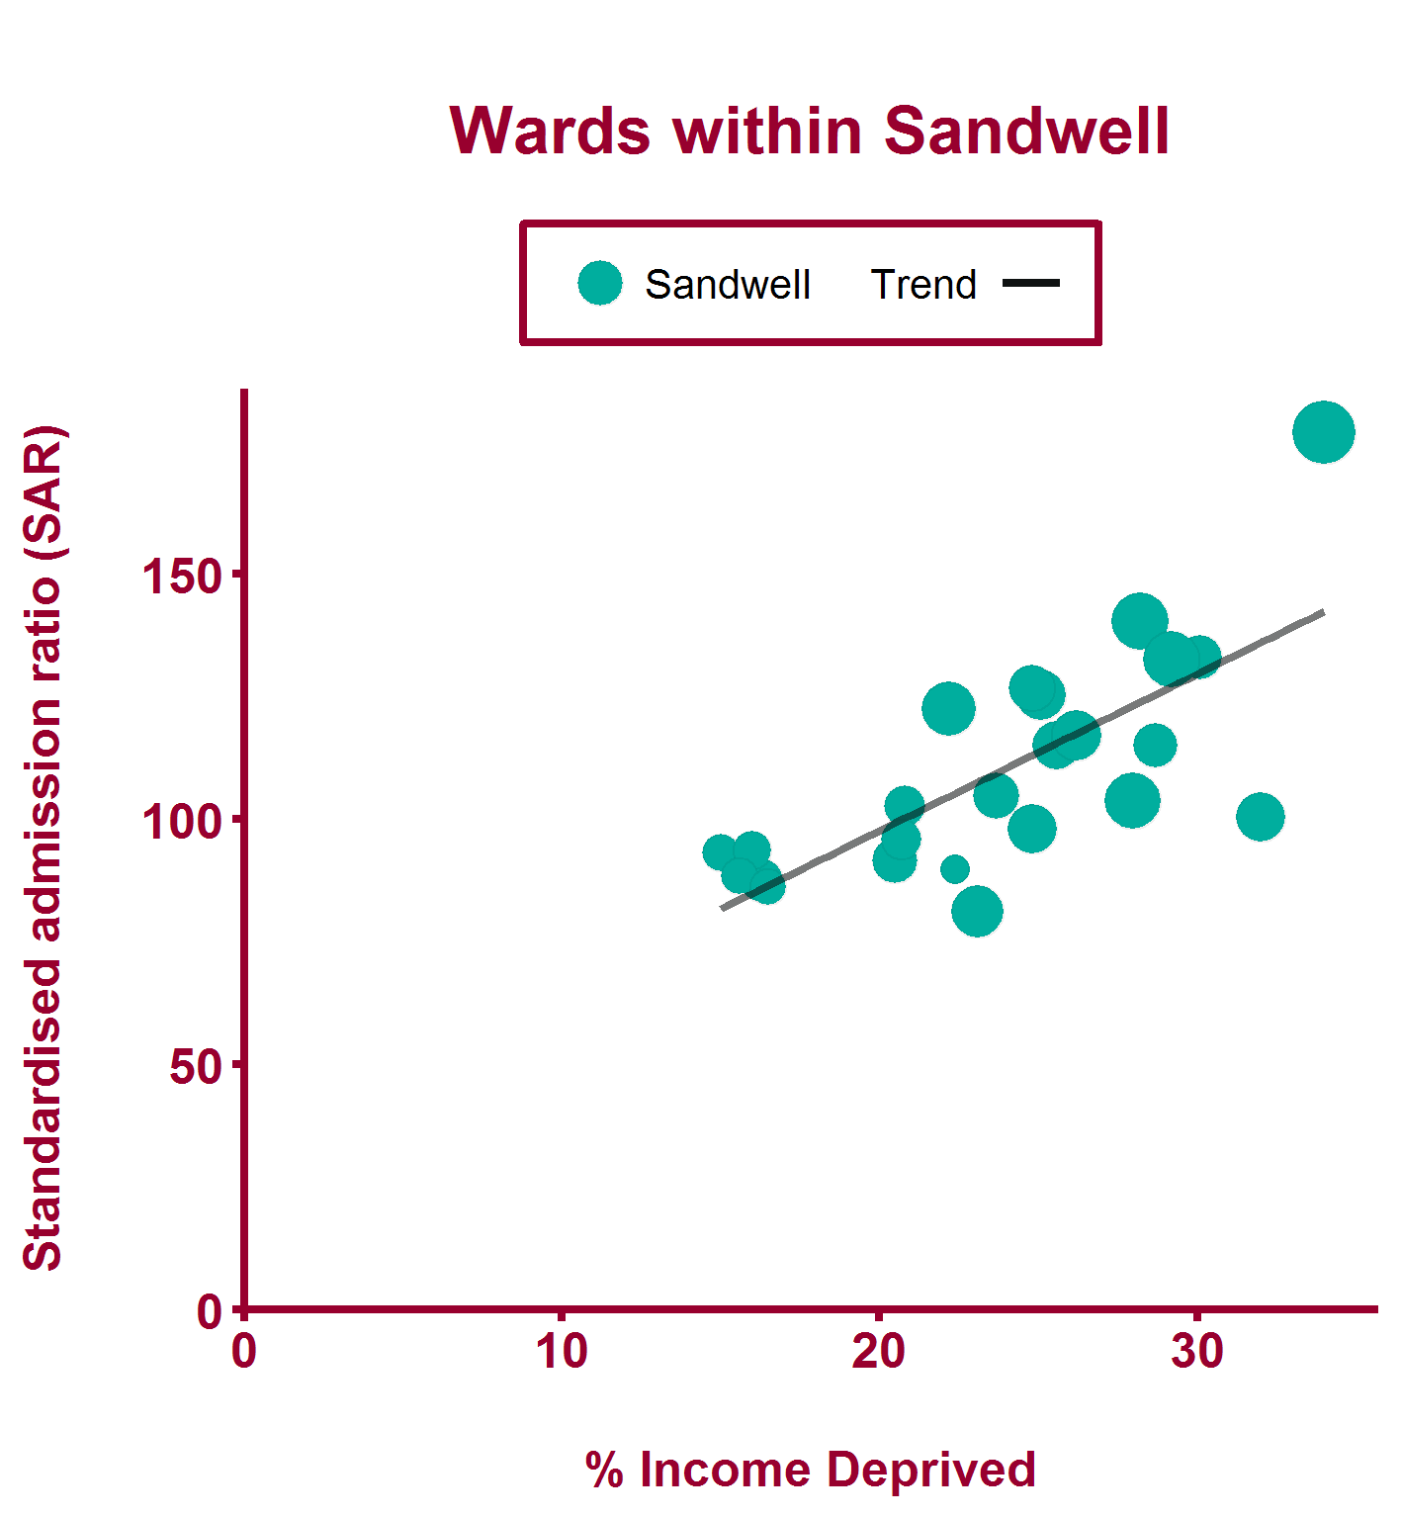
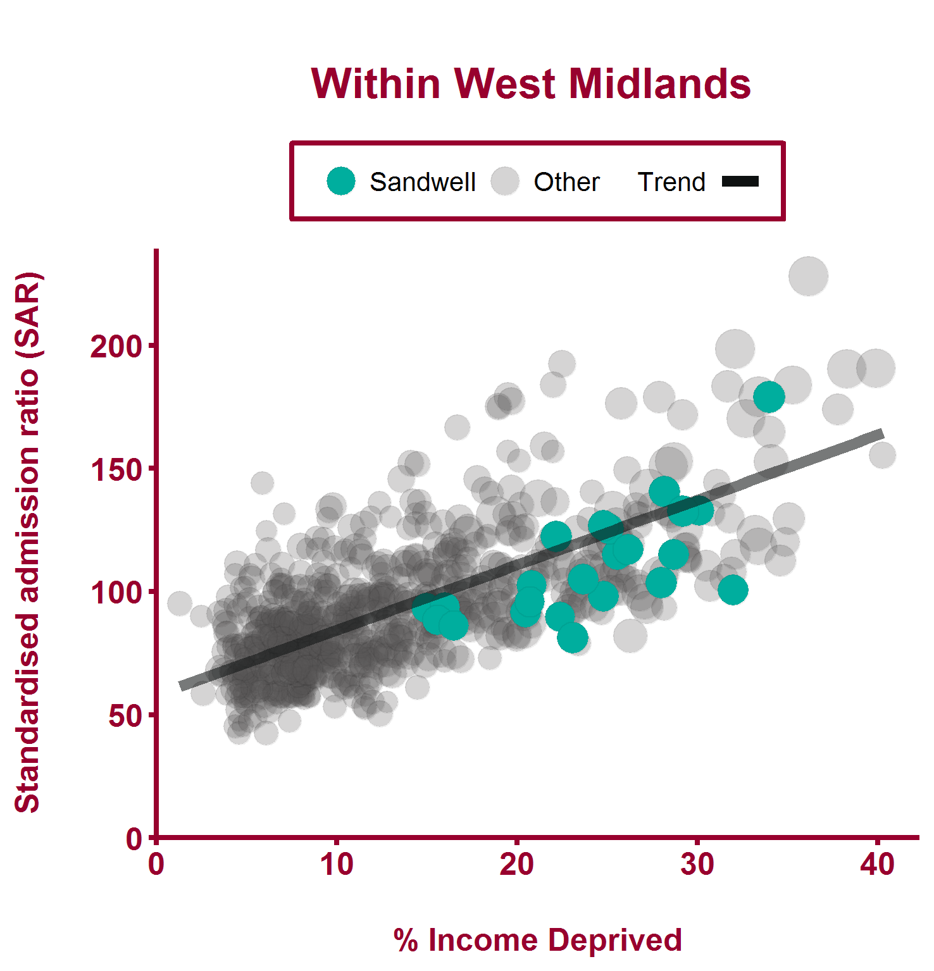
Emergency hospital admissions for CHD (2011/12-2015/16)
Health Inequalities in Sandwell Version 1.3 Released March 2018

Slide 19
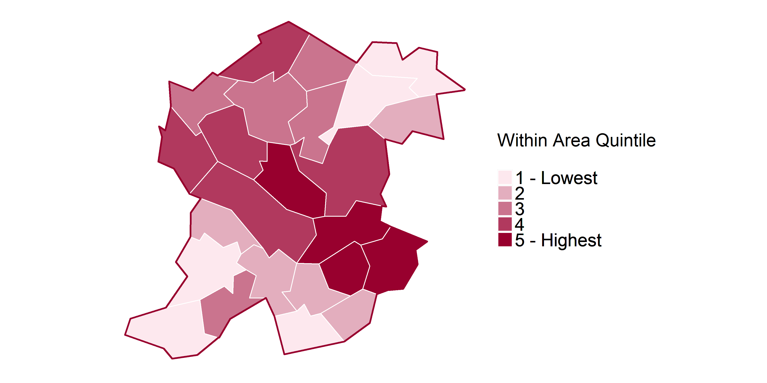
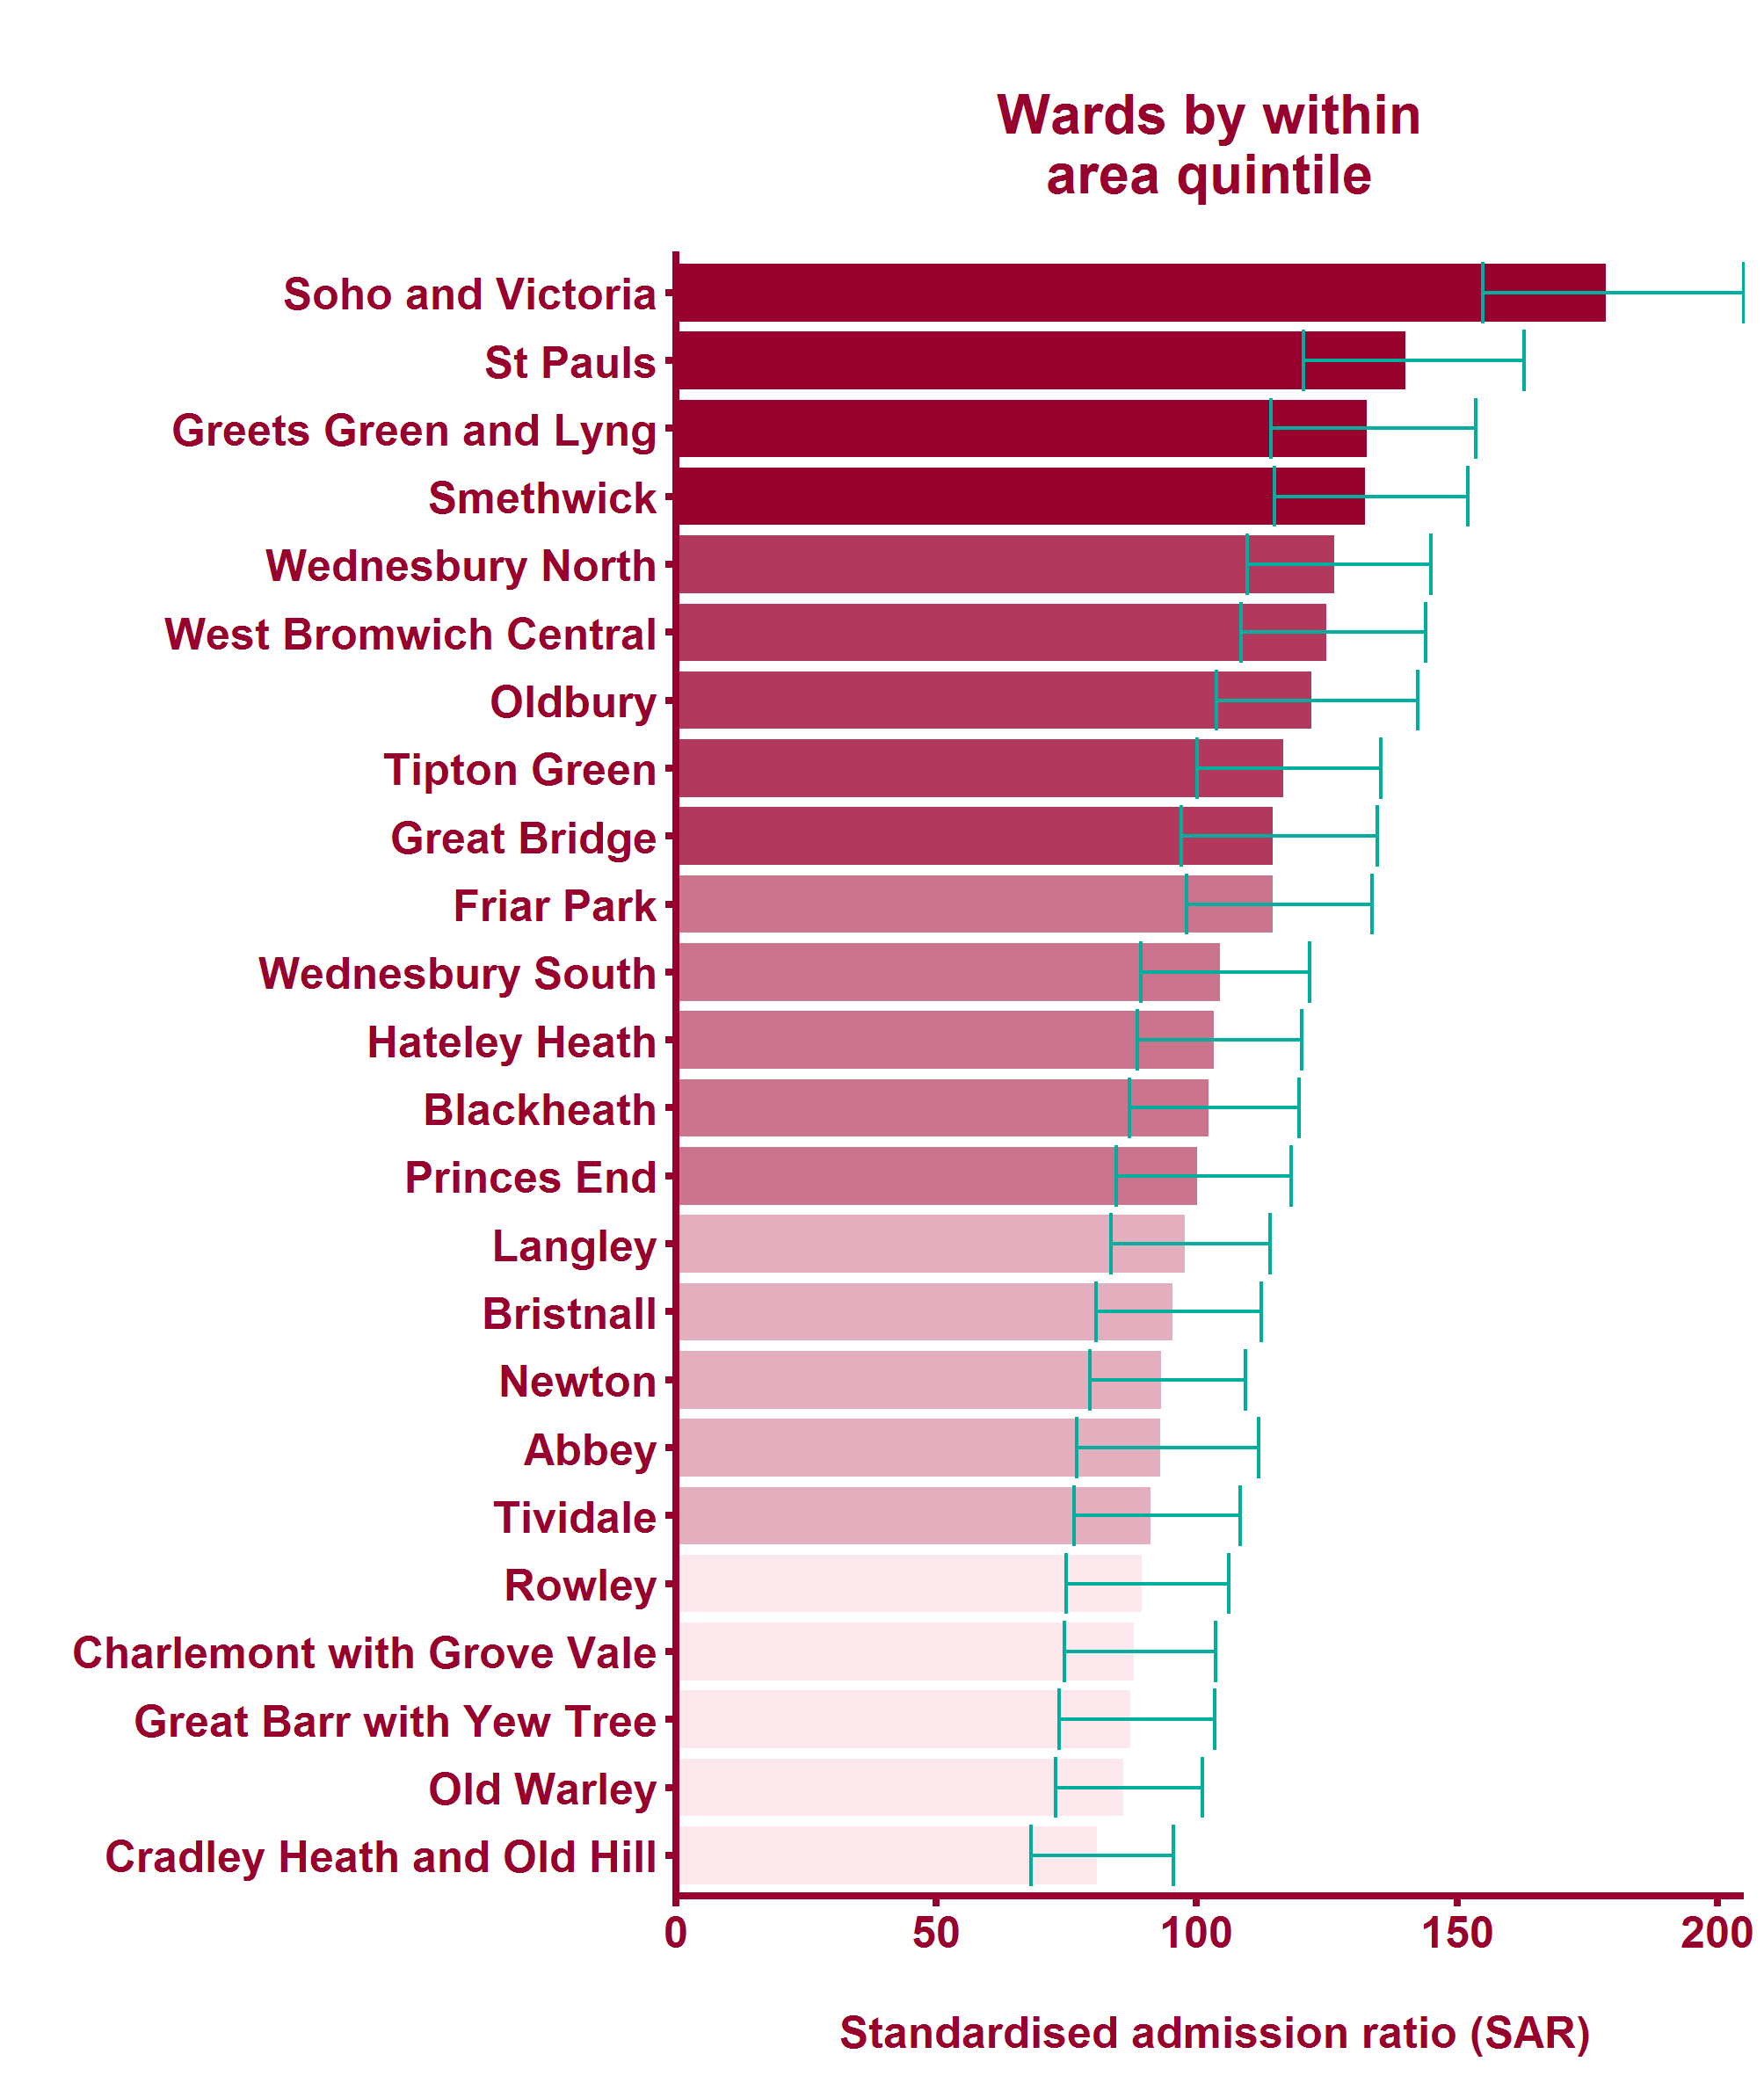
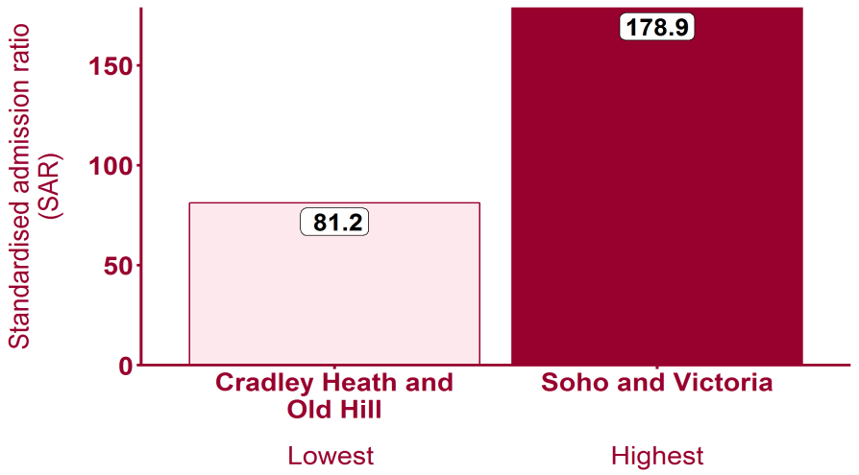
Emergency hospital admissions for CHD (2011/12-2015/16)
Health Inequalities in Sandwell Version 1.3 Released March 2018

Slide 20
Global Burden of Disease: Cerebrovascular disease
Health Inequalities in Sandwell Version 1.3 Released March 2018

Slide 21
Cerebrovascular disease - National picture
Health Inequalities in Sandwell Version 1.3 Released March 2018
Notes:
Seshadri S, Beiser A, Kelly-Hayes M, Kase CS, Au R, Kannel WB, Wolf PA (2006). The Lifetime Risk of Stroke: Estimates from the Framingham Study. Stroke. 2006; 37: 345-350 Further key stroke statistics: Stroke https://www.stroke.org.uk/sites/default/files/state_of_the_nation_2017_final_1.pdf

Slide 22
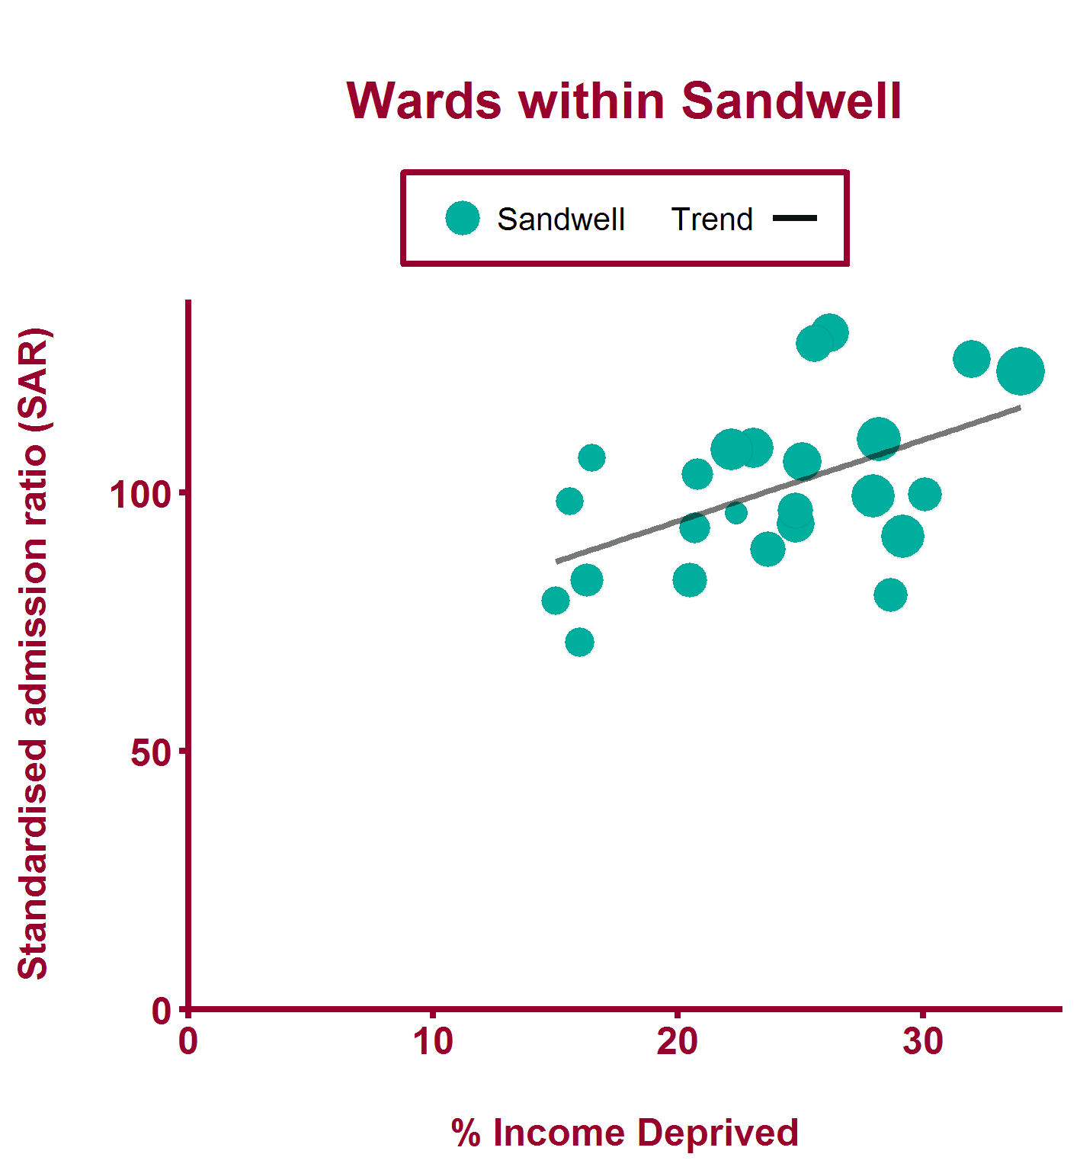
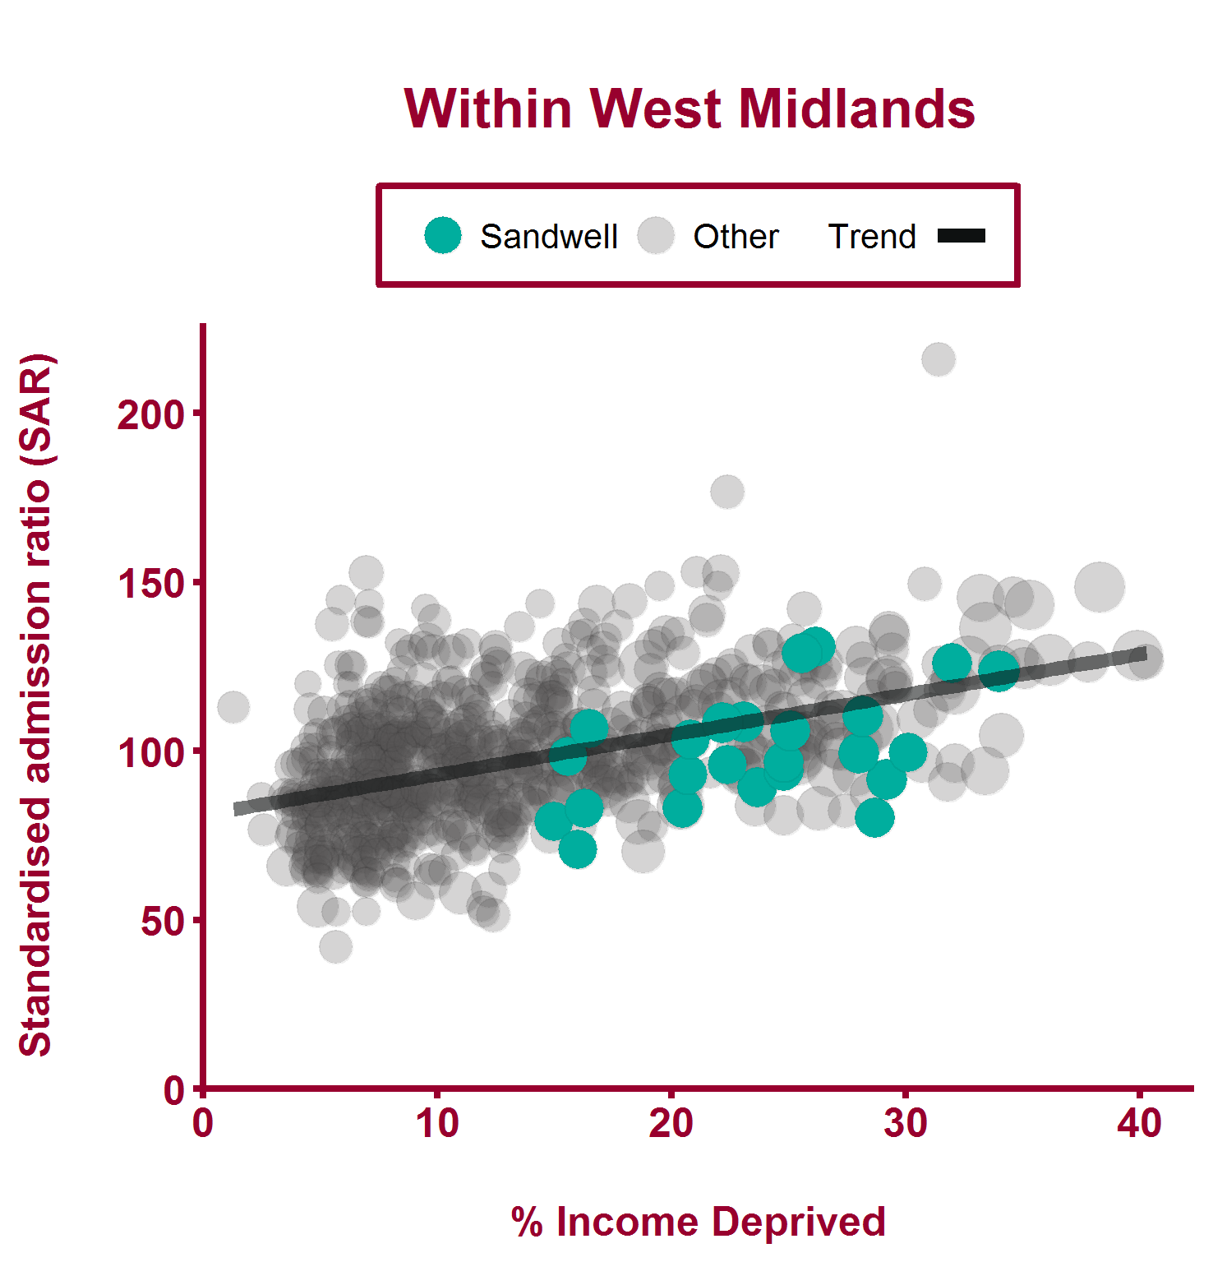
Emergency hospital admissions for stroke (2011/12-2015/16)
Health Inequalities in Sandwell Version 1.3 Released March 2018

Slide 23
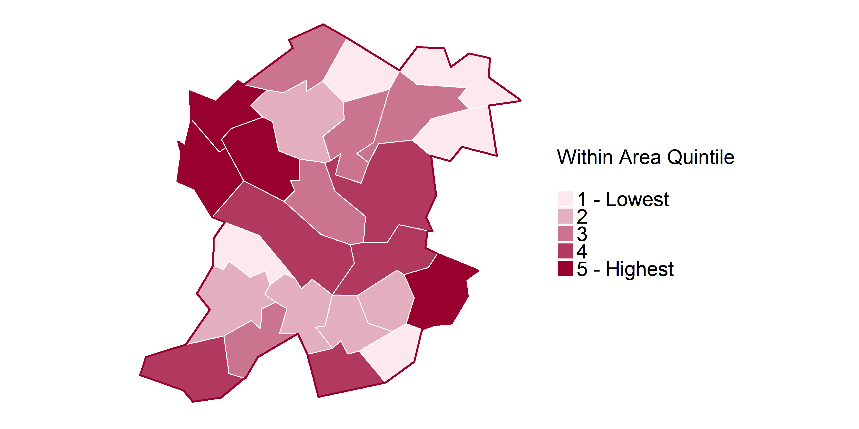
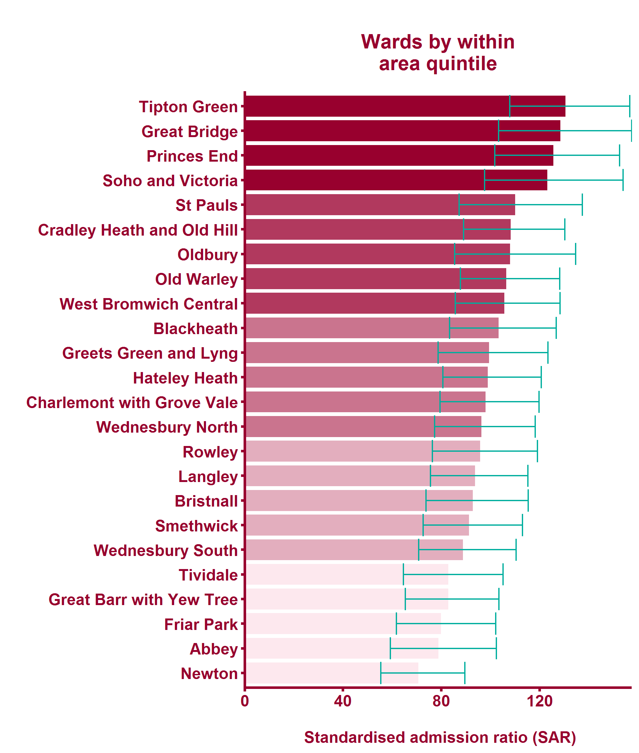
Emergency hospital admissions for stroke (2011/12-2015/16)
Health Inequalities in Sandwell Version 1.3 Released March 2018

Slide 24
Global Burden of Disease: Skin and subcutaneous diseases
Health Inequalities in Sandwell Version 1.3 Released March 2018

Slide 25
Skin and subcutaneous diseases - National picture
Health Inequalities in Sandwell Version 1.3 Released March 2018
Notes:
Note: No local data currently available from local health 60% of British people suffer or have suffered from a skin disease in their lifetime Source: British Skin Foundation, www.britishskinfoundation.org.uk

Slide 26
Global Burden of Disease: Tracheal, bronchus, and lung cancer
Health Inequalities in Sandwell Version 1.3 Released March 2018

Slide 27
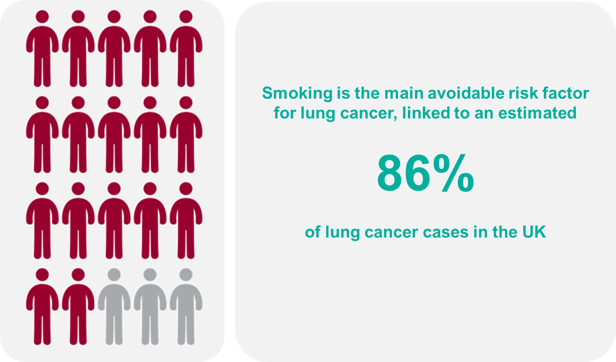
Lung cancer - National picture
Health Inequalities in Sandwell Version 1.3 Released March 2018
Notes:
Compared with the mean European 5-year relative survival, over 3,500 lung cancer deaths could be avoided each year Source: Abdel-Rahman et al, British Journal of Cancer (2009) 101, S115-S124 (03 December 2009) https://www.ncbi.nlm.nih.gov/pubmed/19956155 Lung cancer (ICD10 C33-34) accounts for over 35,000 deaths in the UK each year accounting for nearly a quarter of all UK cancer deaths (22%). Source: Cancer Research UK, http://www.cancerresearchuk.org/health-professional/cancer-statistics/statistics-by-cancer-type/lung-cancer

Slide 28
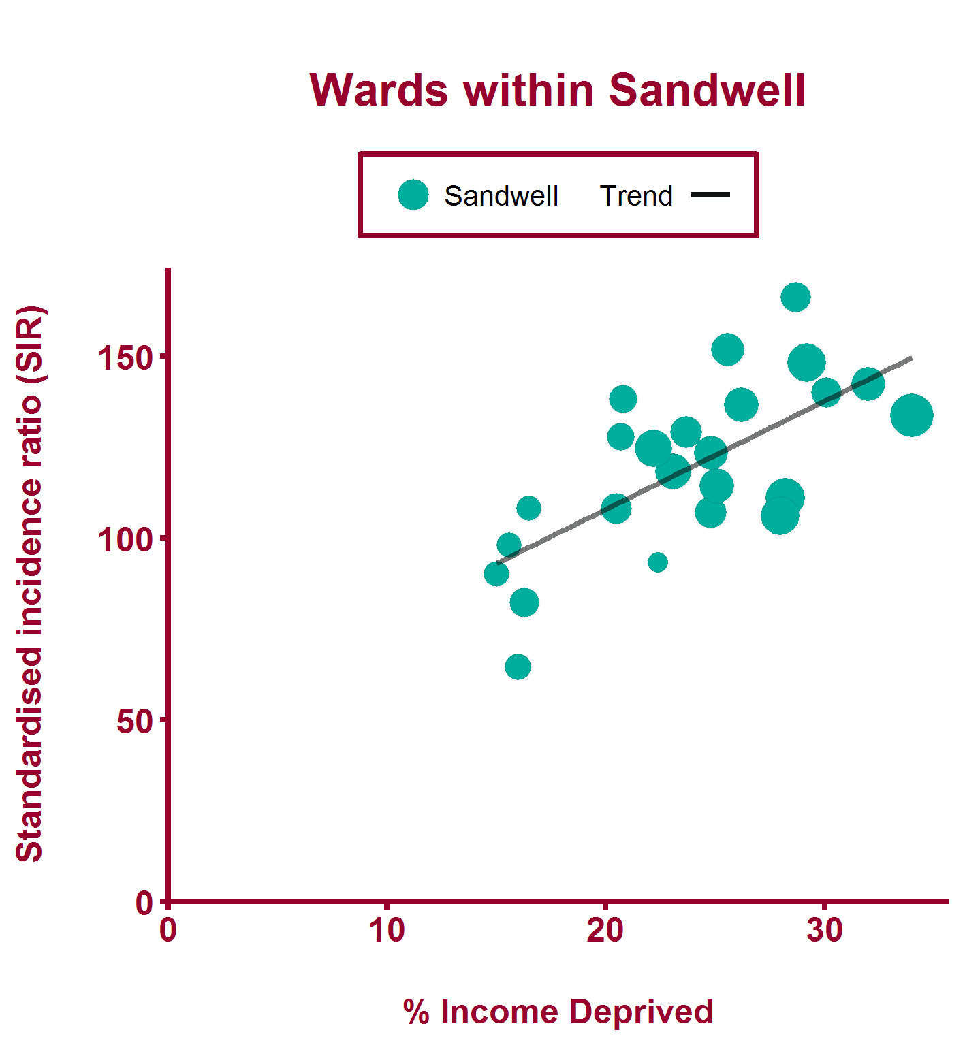
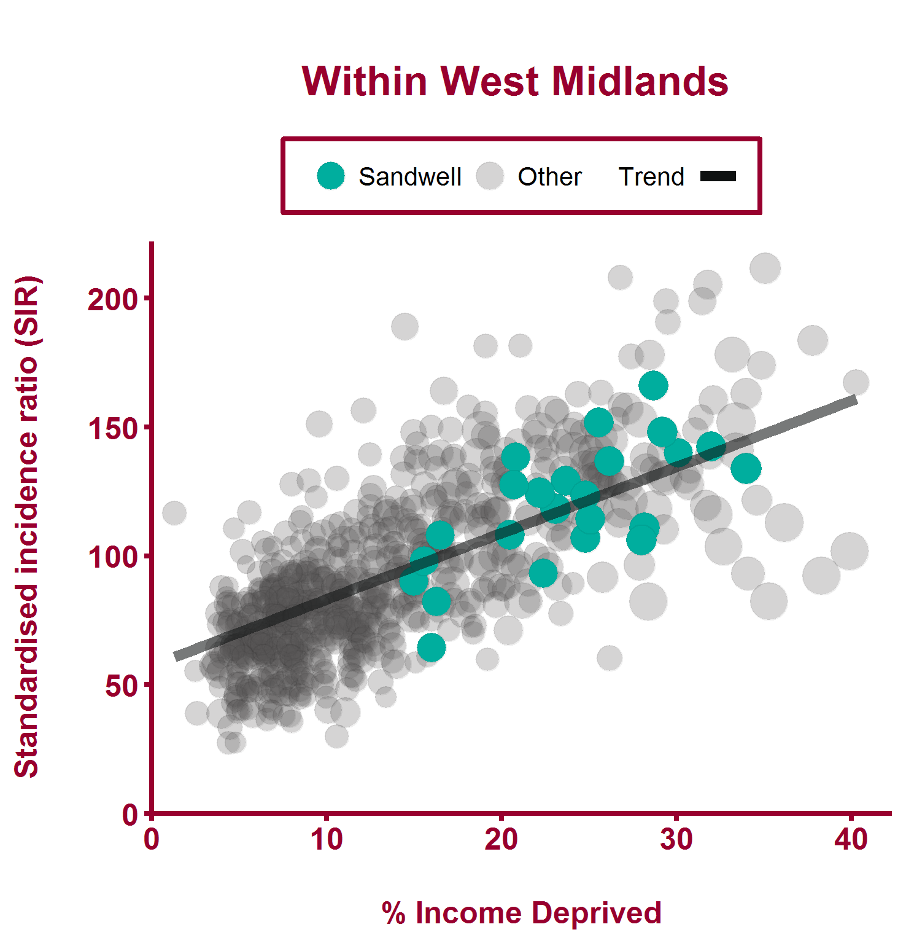
Incidence of lung cancer (2011 - 2015)
Health Inequalities in Sandwell Version 1.3 Released March 2018

Slide 29
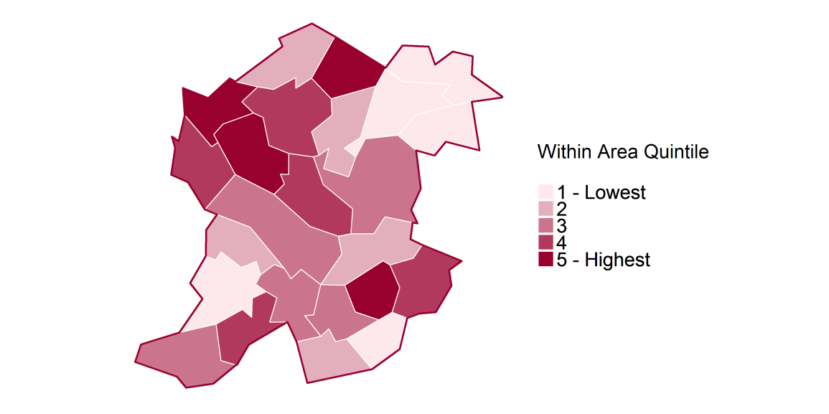
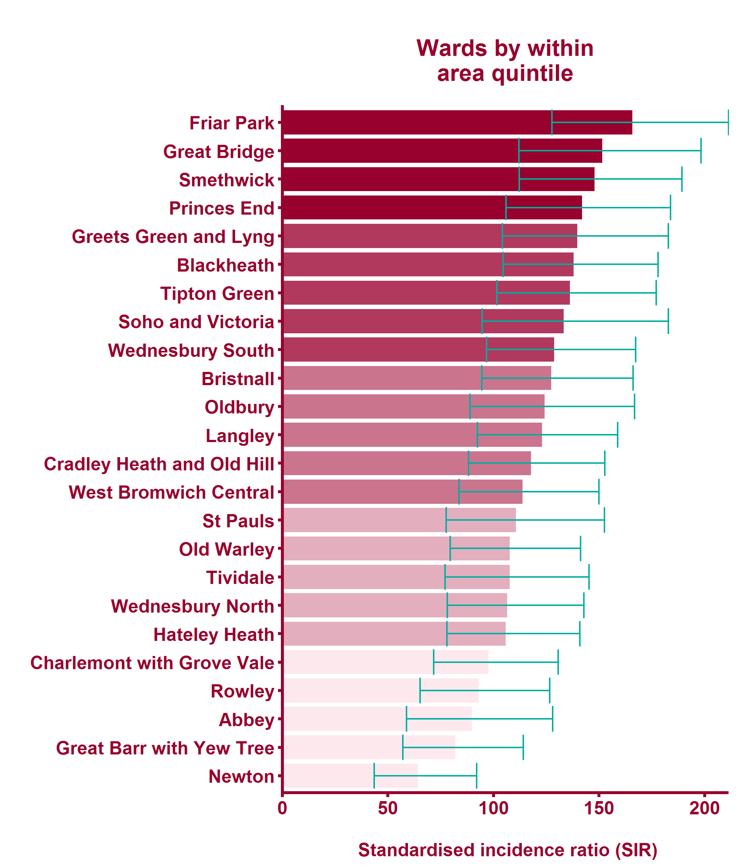
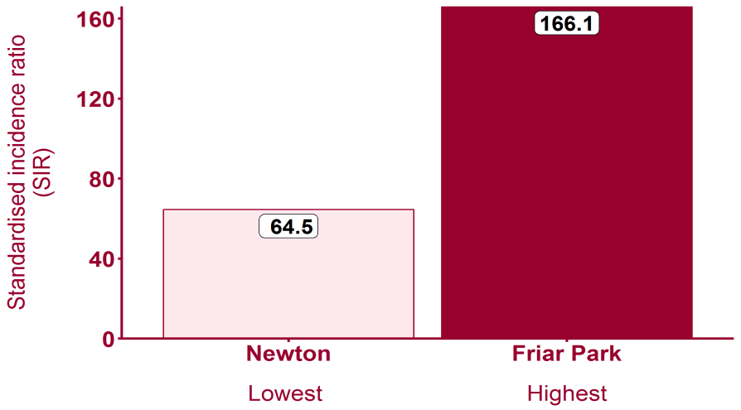
Incidence of lung cancer (2011 - 2015)
Health Inequalities in Sandwell Version 1.3 Released March 2018

Slide 30
Global Burden of Disease: Sense organ diseases
Health Inequalities in Sandwell Version 1.3 Released March 2018

Slide 31
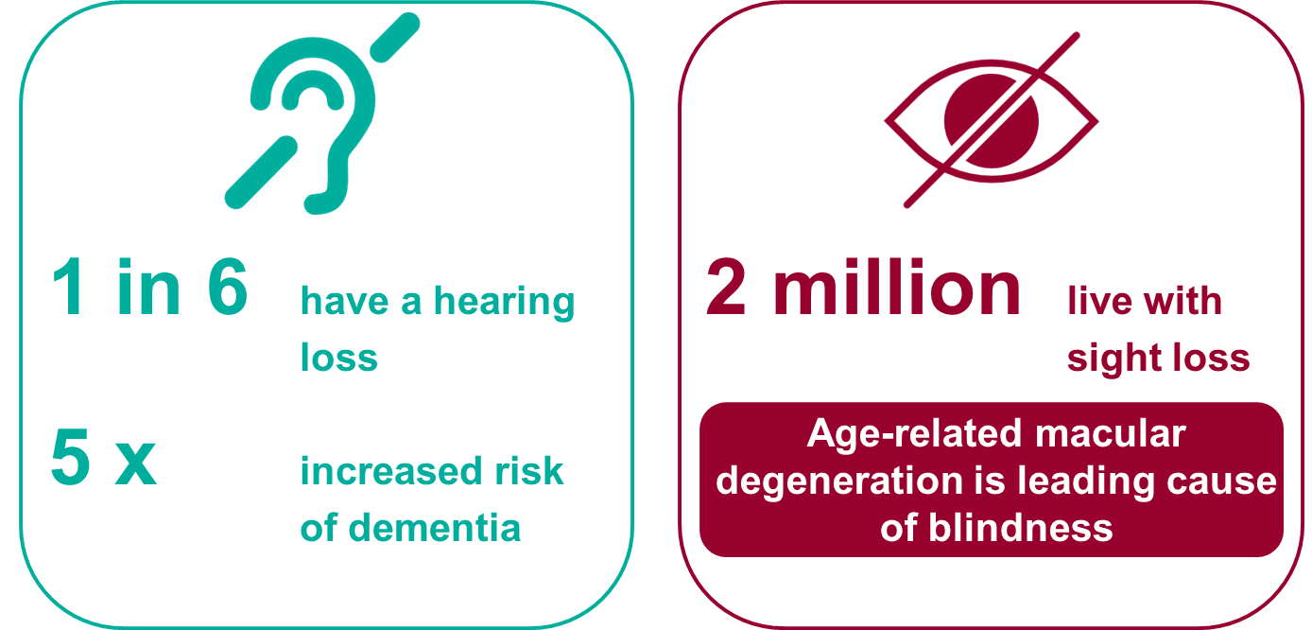
Sense organ diseases - National picture
Health Inequalities in Sandwell Version 1.3 Released March 2018
Notes:
Note: No local data currently available from local health There are 11 million people in the UK with a hearing loss, 1 in 6. An estimated 900,000 have severe or profound hearing loss 1 in 10 adults has tinnitus Hearing loss can increase the risk of dementia by up to 5 times Only around 40% of people who need hearing aids have them Source: www.actionon hearingloss.org.uk

Slide 32
Global Burden of Disease: Alzheimer's disease and other dementias
Health Inequalities in Sandwell Version 1.3 Released March 2018

Slide 33
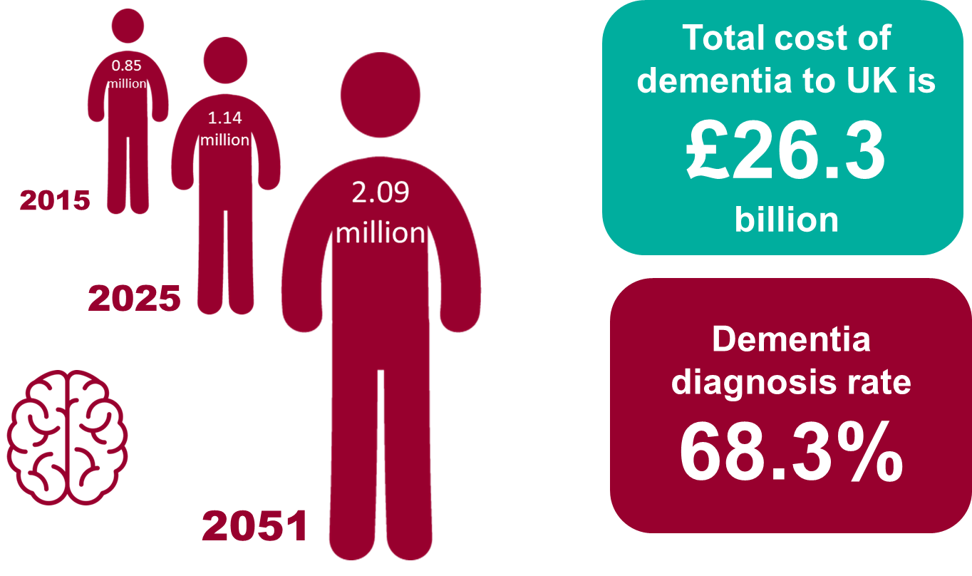
Alzheimer's disease and other dementias - National picture
Health Inequalities in Sandwell Version 1.3 Released March 2018
Notes:
Note: No local data currently available from local health Estimates from the Alzheimer's Society predict a rise to over 2 million by 2051. Dementia is estimated to cost the UK 26.3 billion a year See http://alzheimers.org.uk/infographic

Slide 34
Global Burden of Disease: Chronic obstructive pulmonary disease
Health Inequalities in Sandwell Version 1.3 Released March 2018

Slide 35
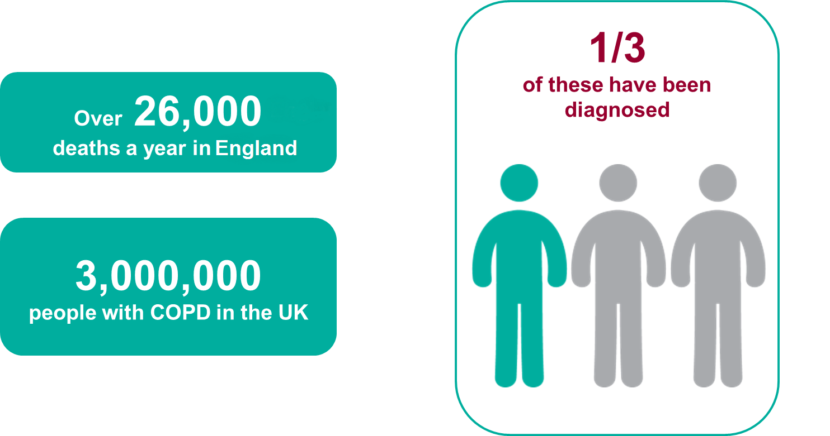
Chronic obstructive pulmonary disease - National picture
Health Inequalities in Sandwell Version 1.3 Released March 2018
Notes:
There were more than 26,000 deaths in England where COPD (ICD10 J40-44) was the underlying cause in 2016. Source: ONS Annual Death registration extracts, 2016 In the UK, it is estimated that more than 3 million people currently have COPD. About 900,000 have diagnosed COPD and an estimated 2 million people have COPD which remains undiagnosed. Most patients are not diagnosed until they are in their fifties. Source: https://www.nice.org.uk/guidance/cg101/chapter/introduction

Slide 36
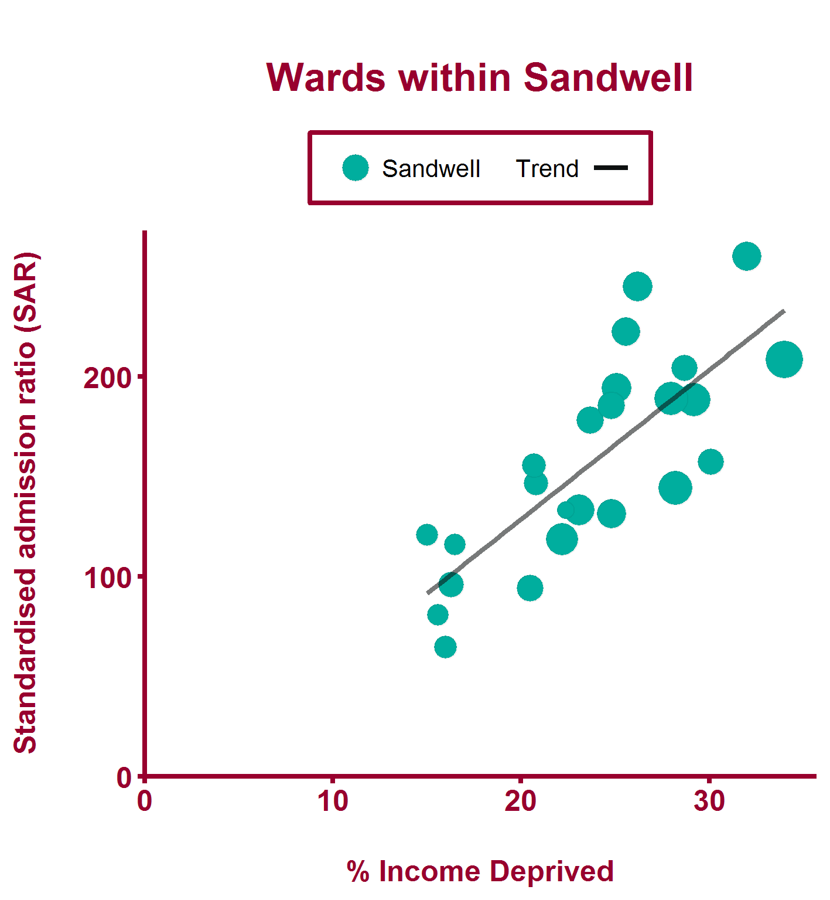
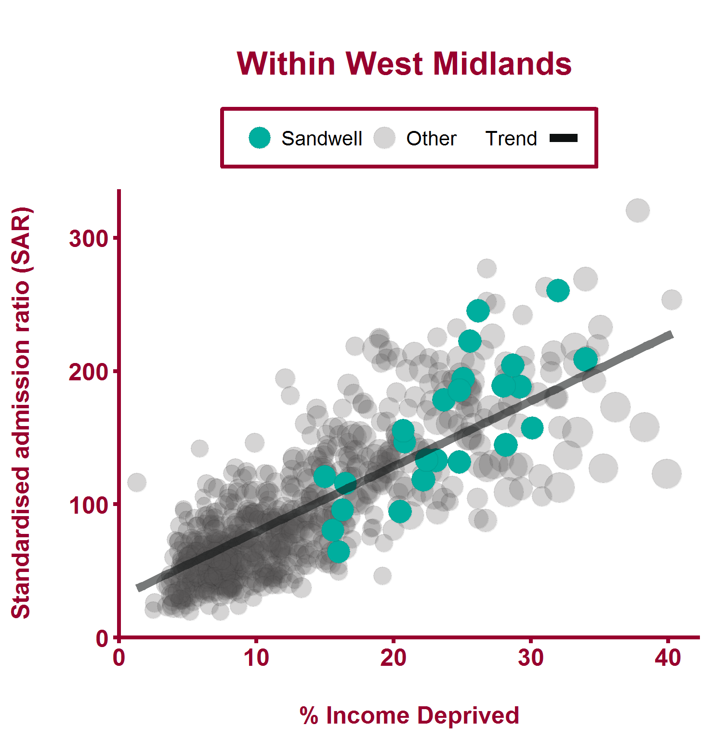
Emergency hospital admissions for COPD (2011/12-2015/16)
Health Inequalities in Sandwell Version 1.3 Released March 2018

Slide 37
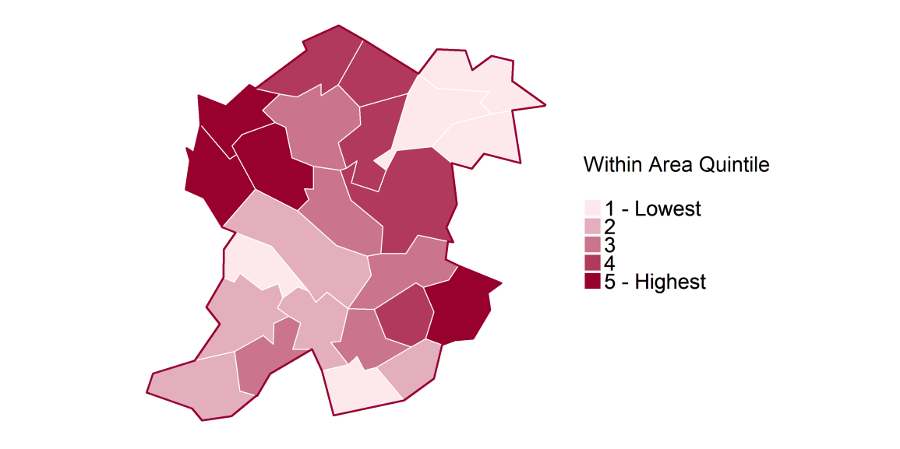
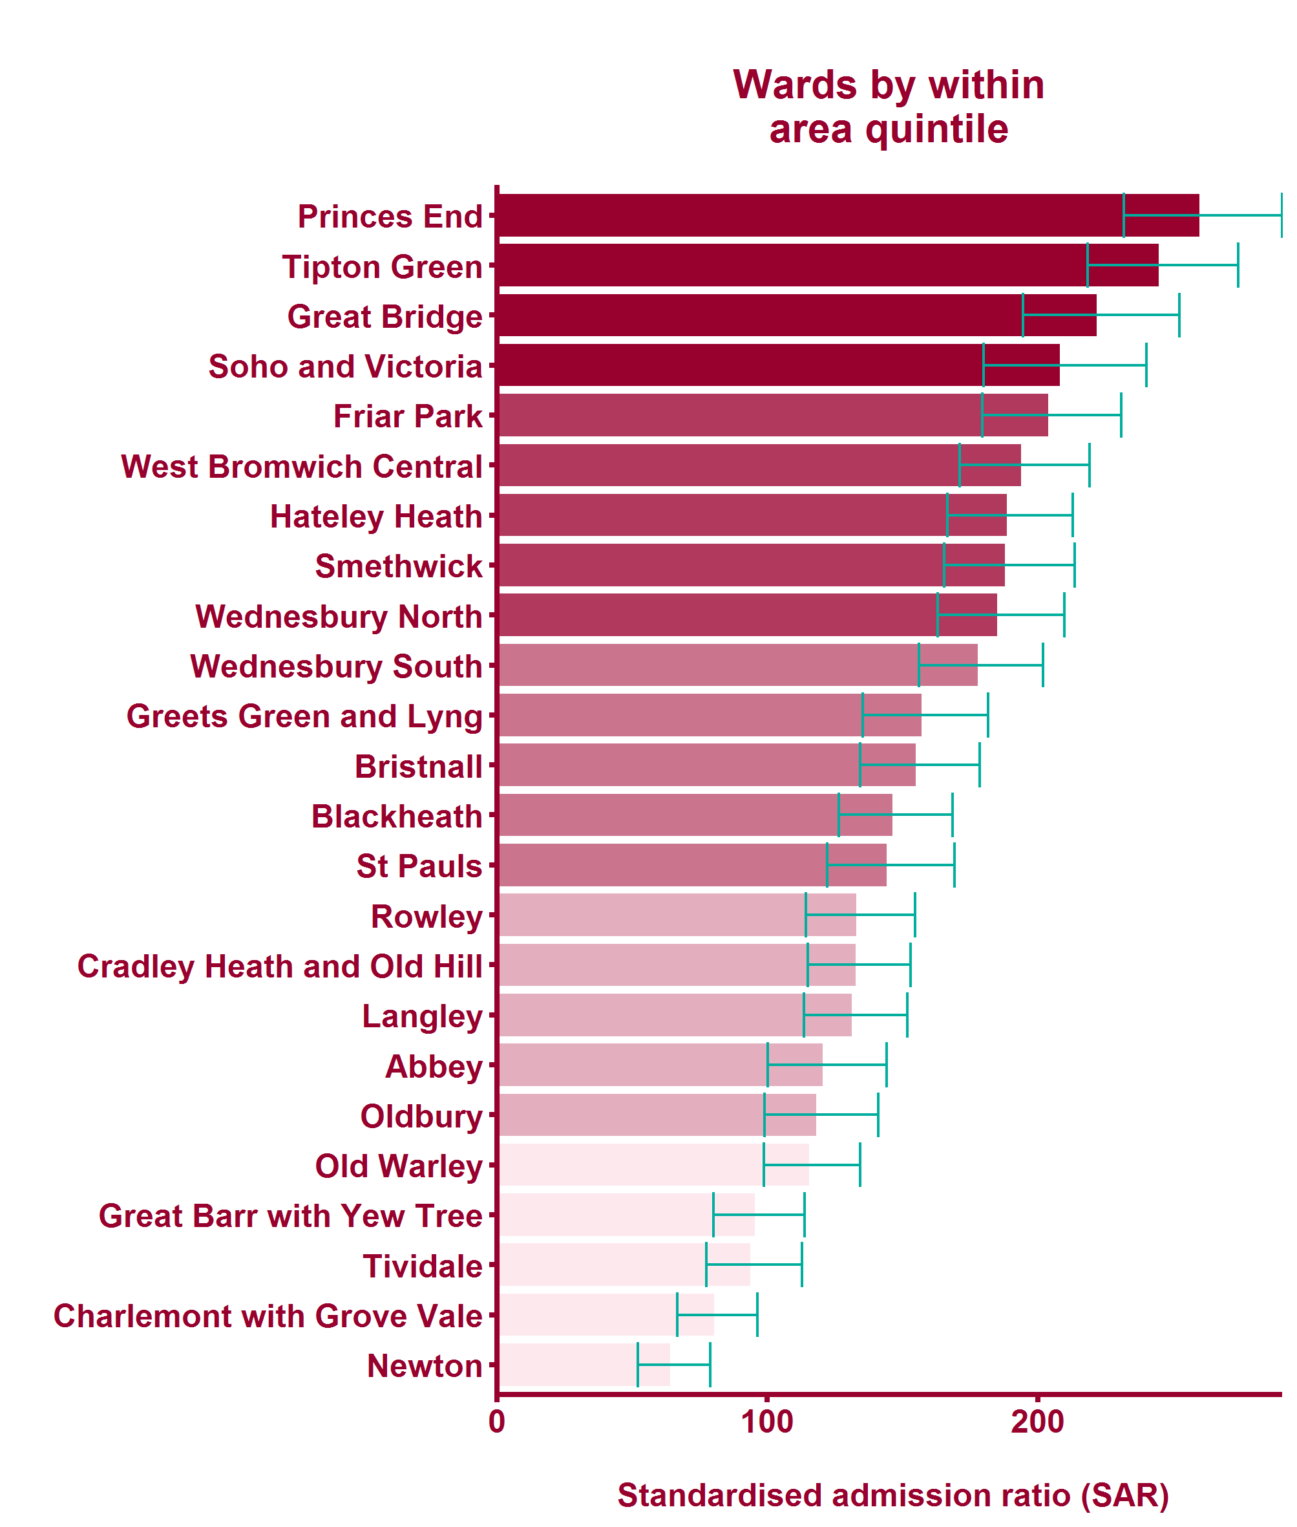
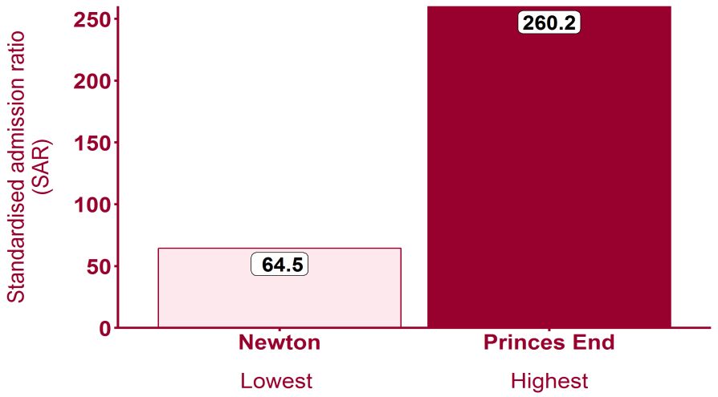
Emergency hospital admissions for COPD (2011/12-2015/16)
Health Inequalities in Sandwell Version 1.3 Released March 2018

Slide 38
Health inequalities within Sandwell
Some other indicators show a particularly strong association with income deprivation
The following slide lists those indicators most strongly associated with deprivation locally, with the top three (not already analysed) explored further
Health Inequalities in Sandwell Version 1.3 Released March 2018

Slide 39
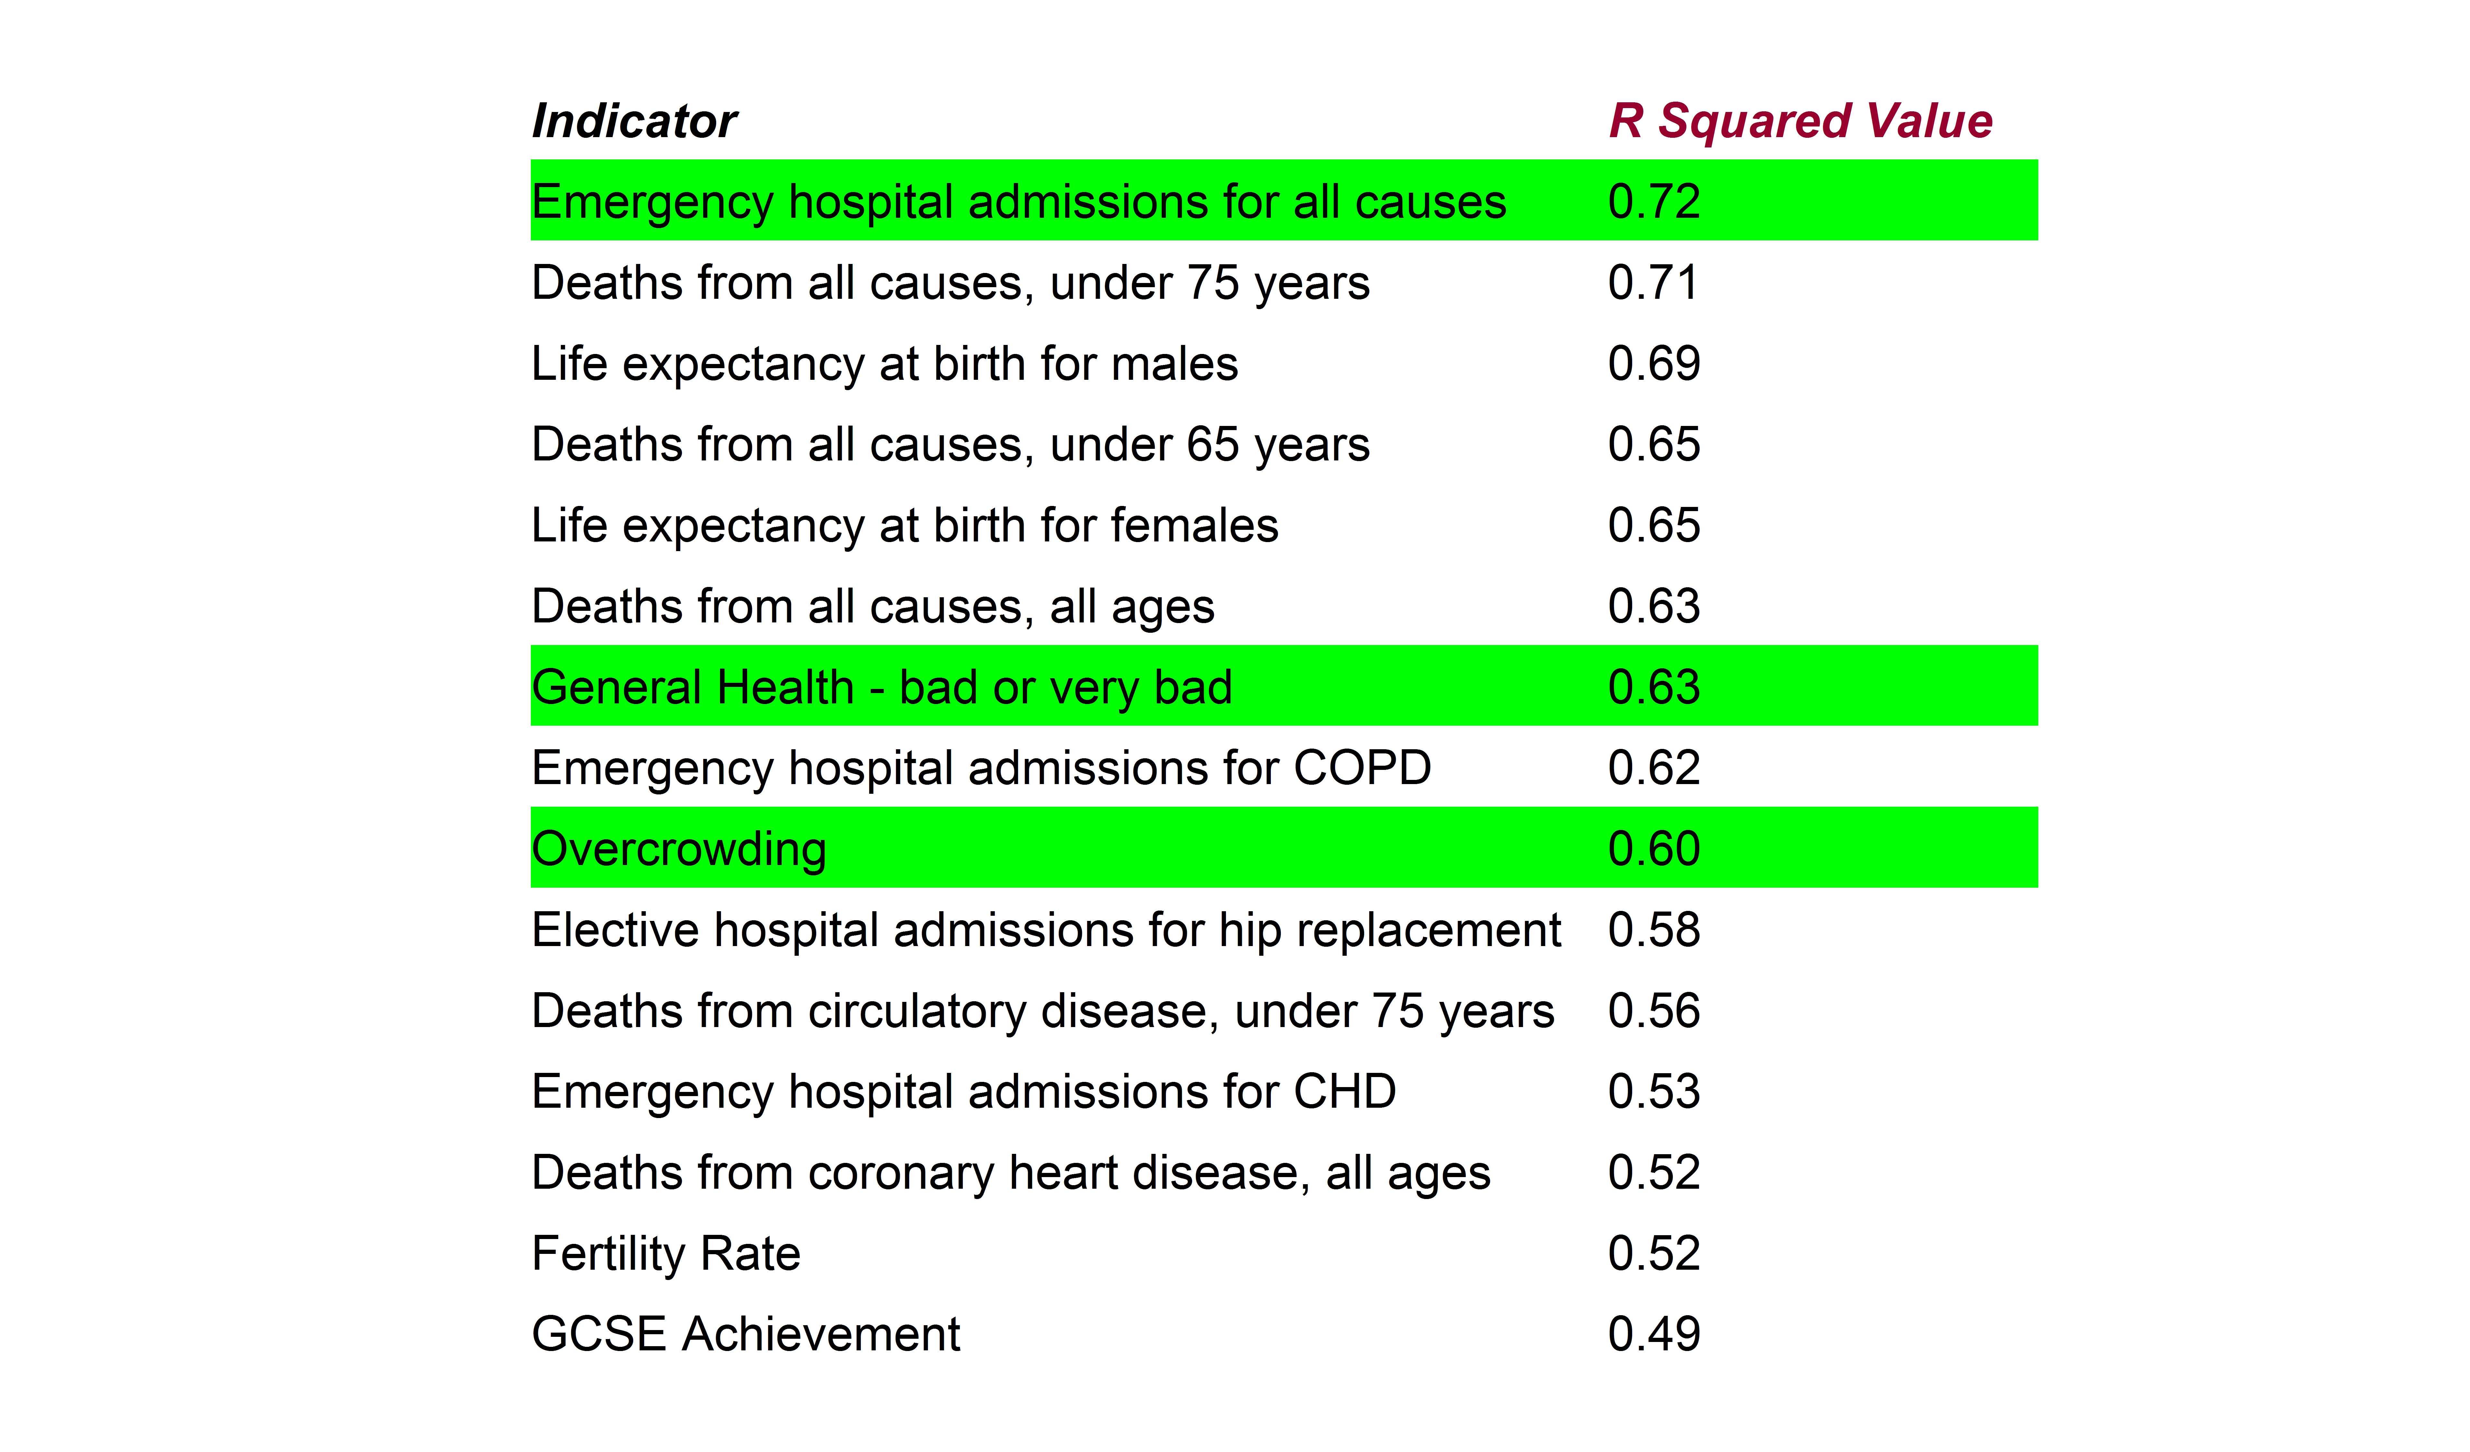
Health inequalities within Sandwell
(Sorted by R Squared Value)
Health Inequalities in Sandwell Version 1.3 Released March 2018
Notes:
All local health indicators listed by strength of R squared value. Other deprivation indicators have been excluded. The three highlighted are further explored in the following slides

Slide 40
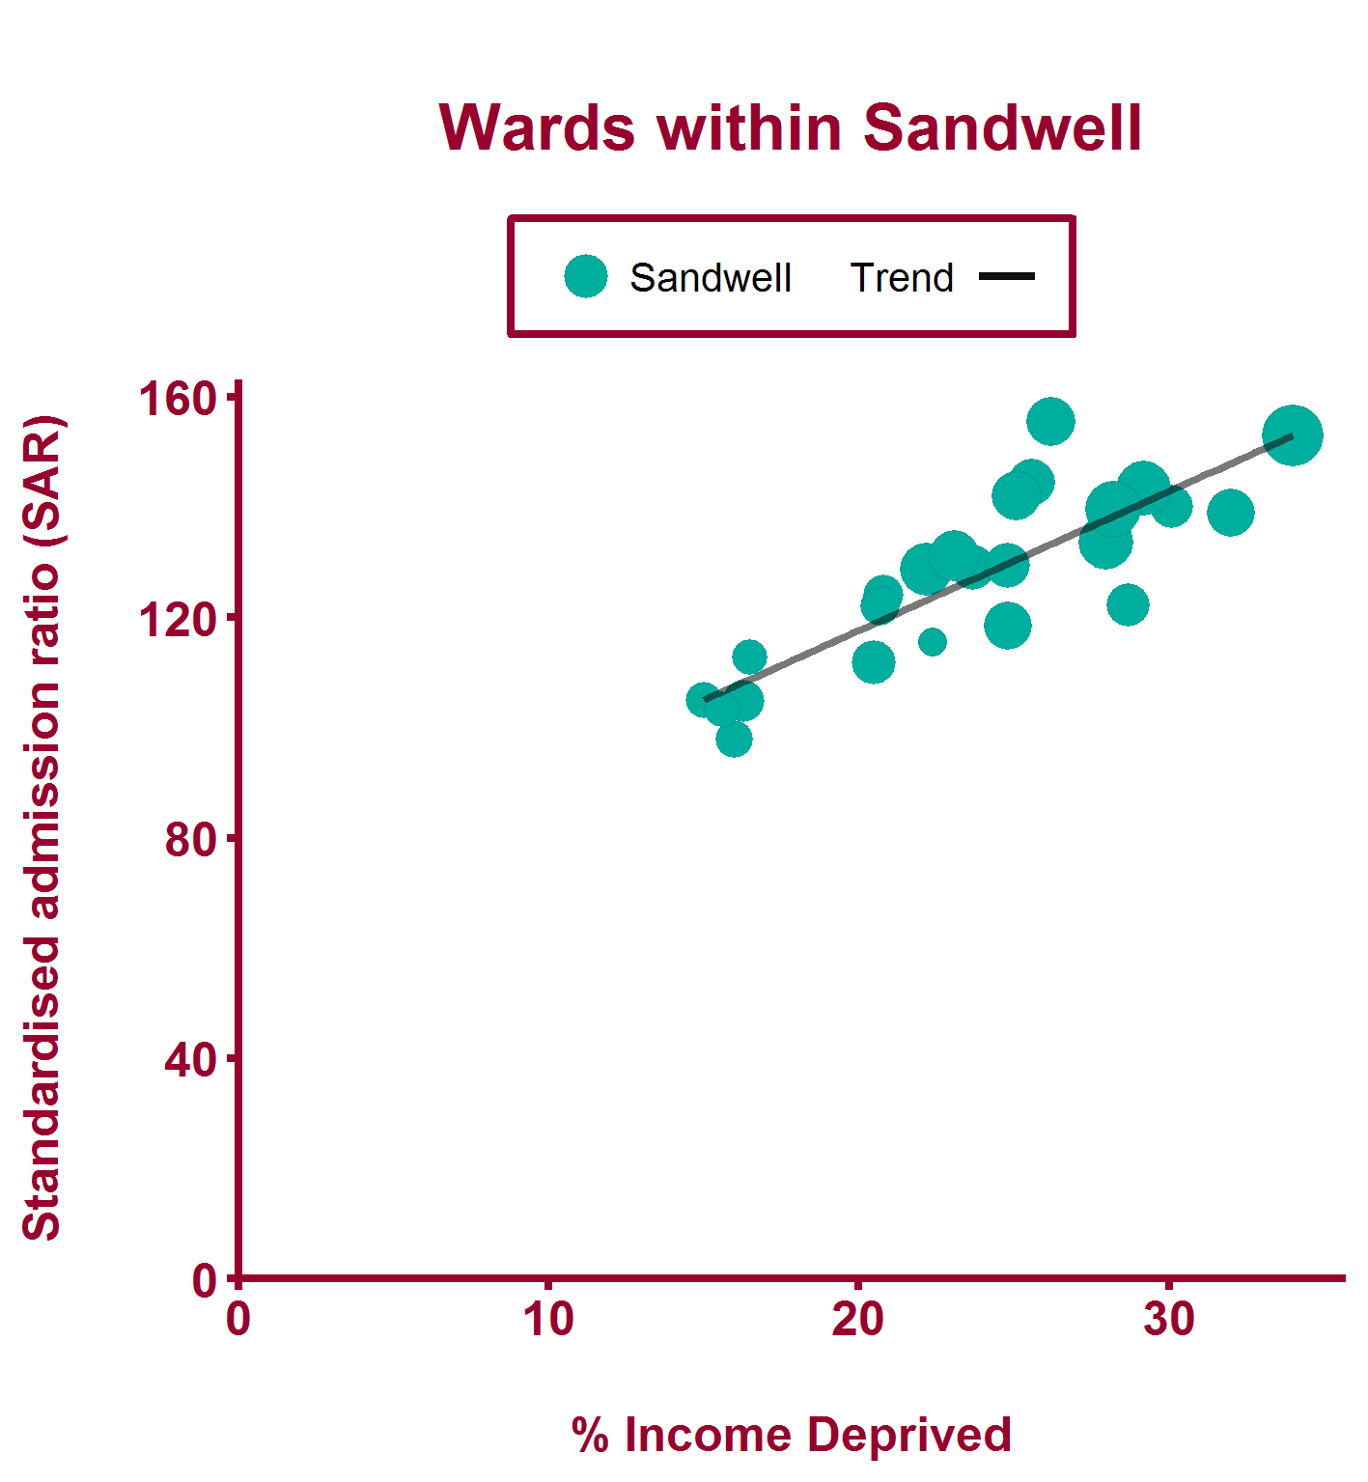
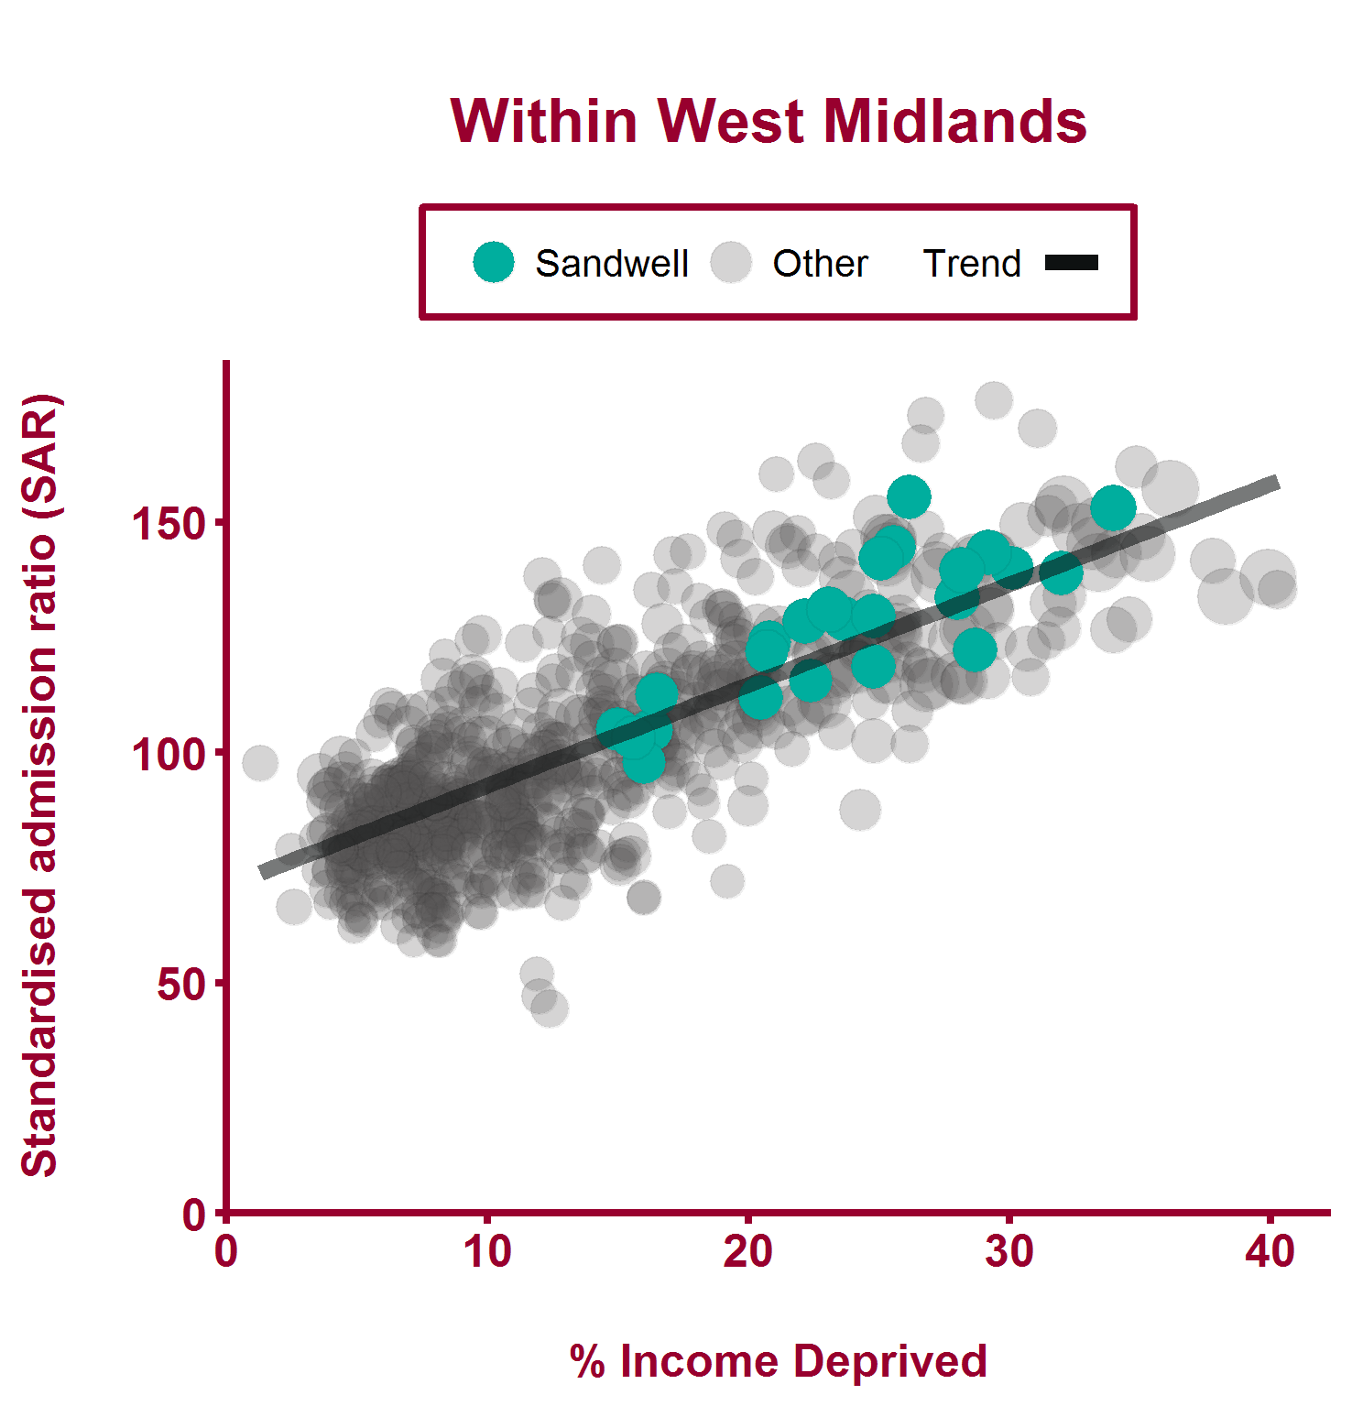
Emergency hospital admissions for all causes (2011/12-2015/16)
Health Inequalities in Sandwell Version 1.3 Released March 2018

Slide 41
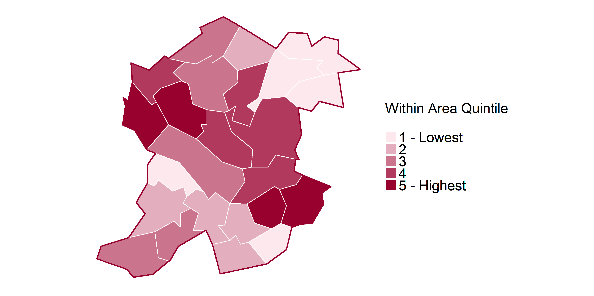
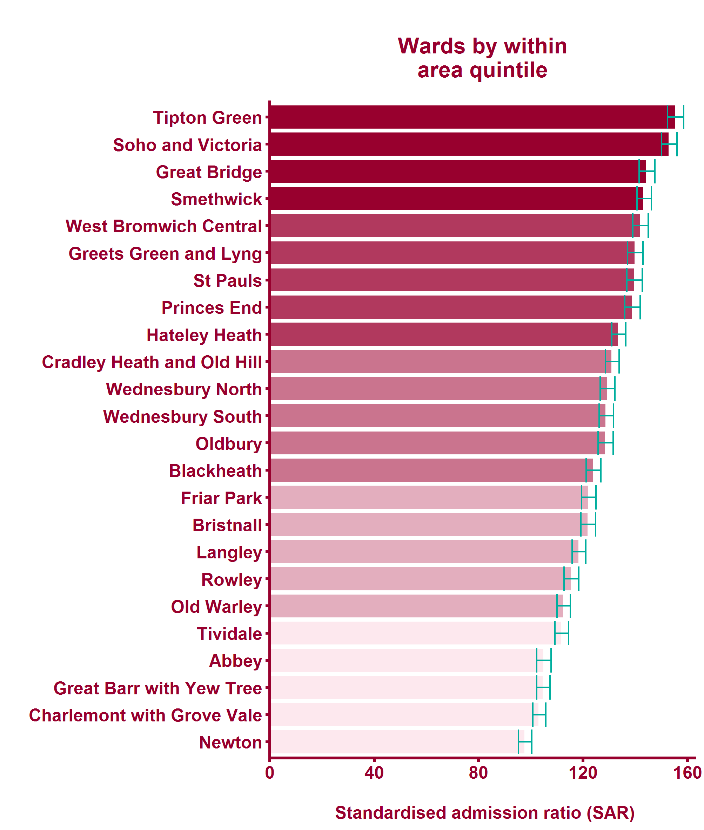
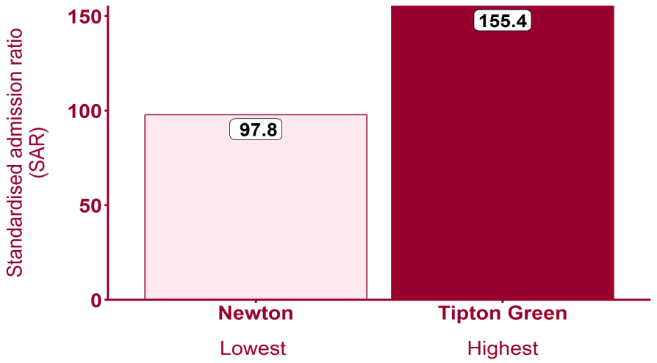
Emergency hospital admissions for all causes (2011/12-2015/16)
Health Inequalities in Sandwell Version 1.3 Released March 2018

Slide 42
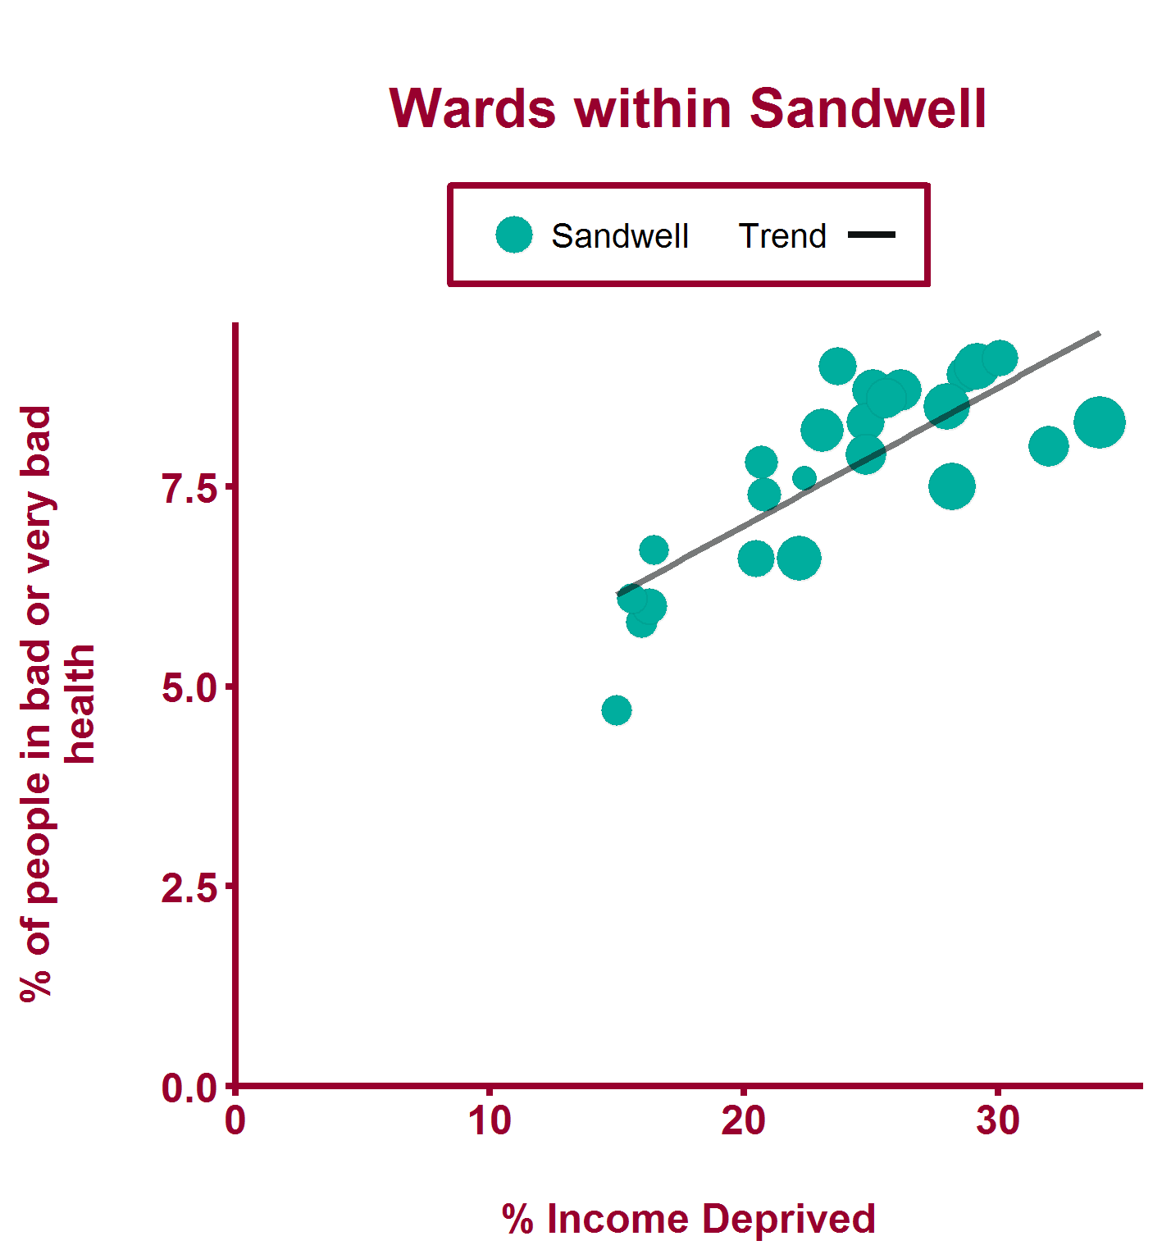
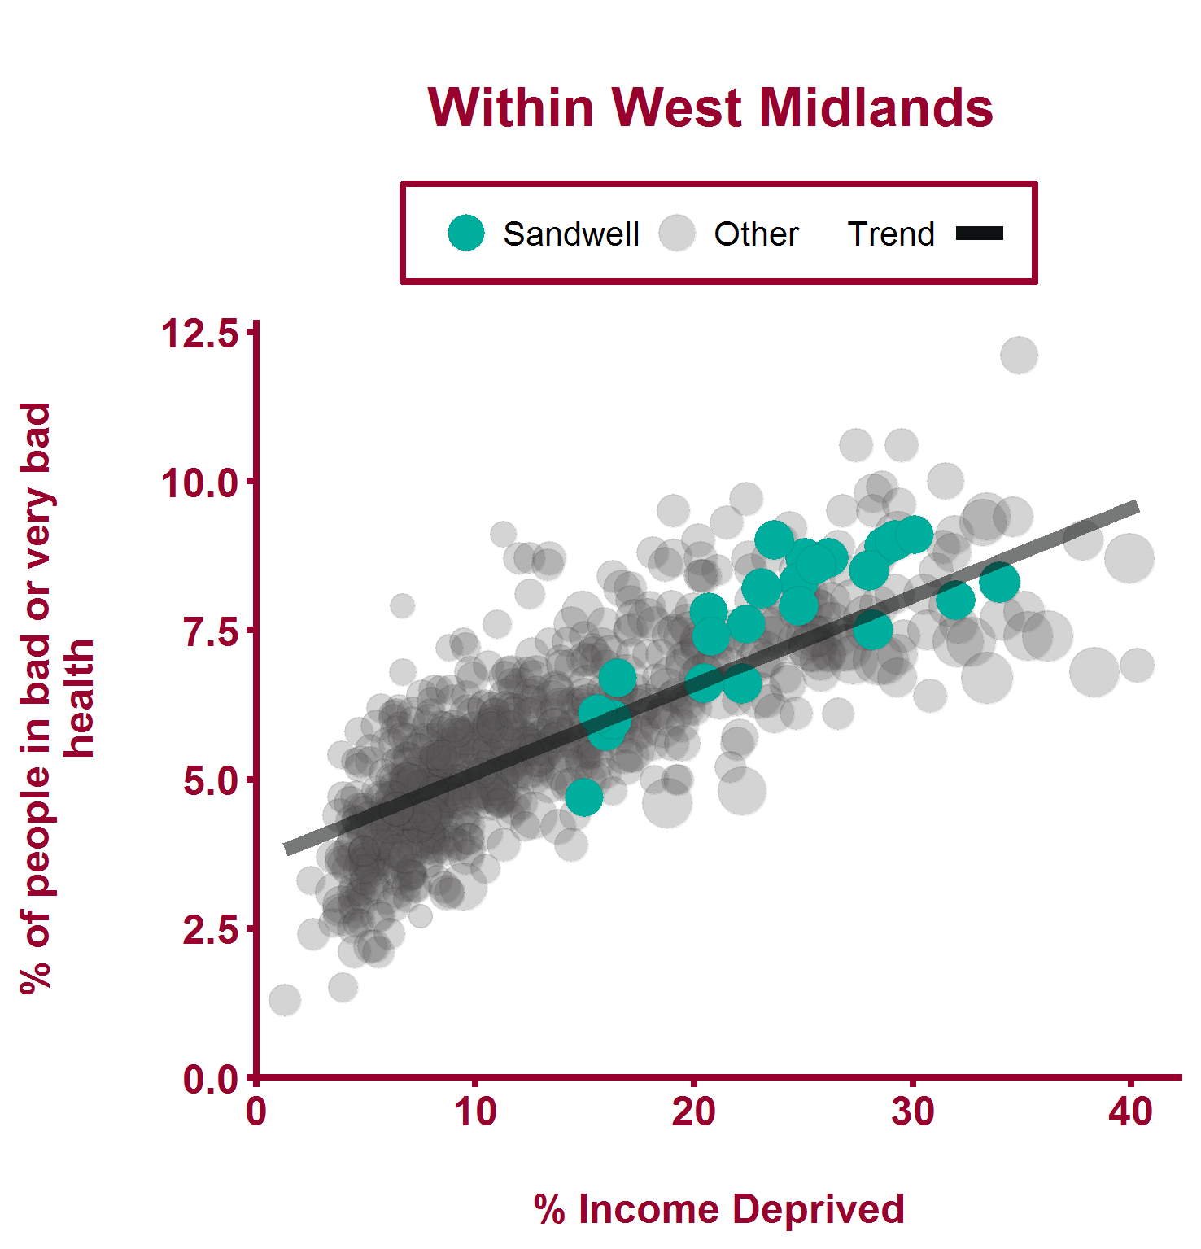
General Health - bad or very bad (2011)
Health Inequalities in Sandwell Version 1.3 Released March 2018

Slide 43
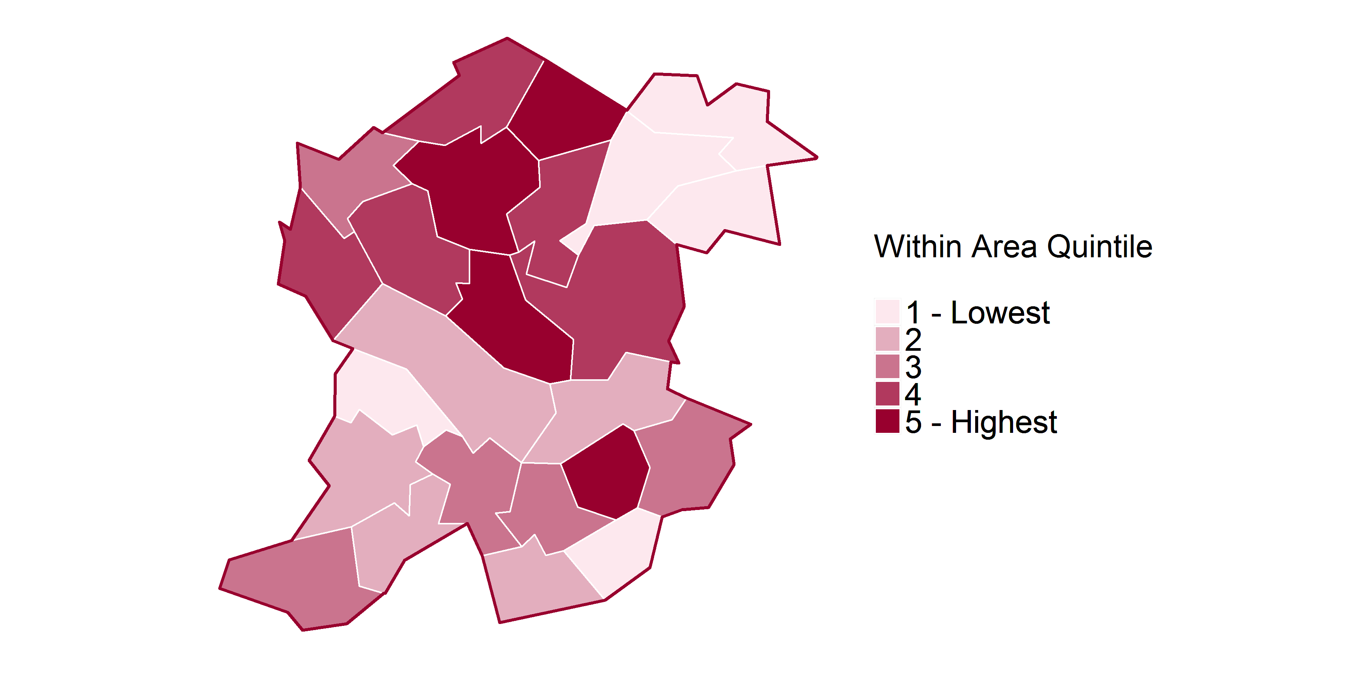
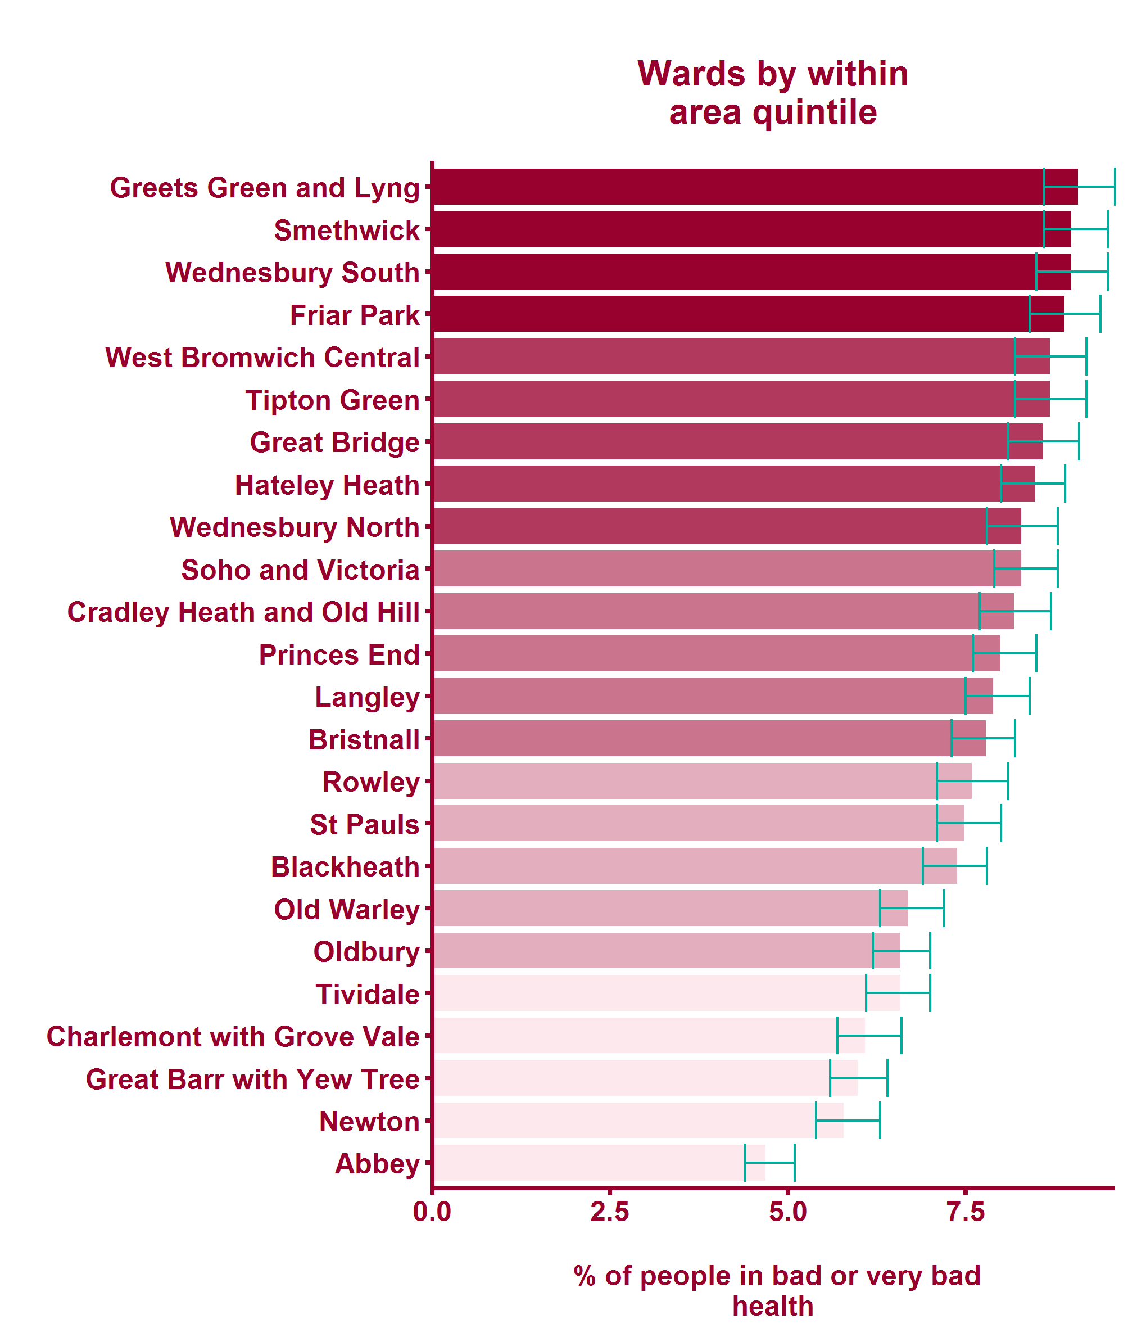
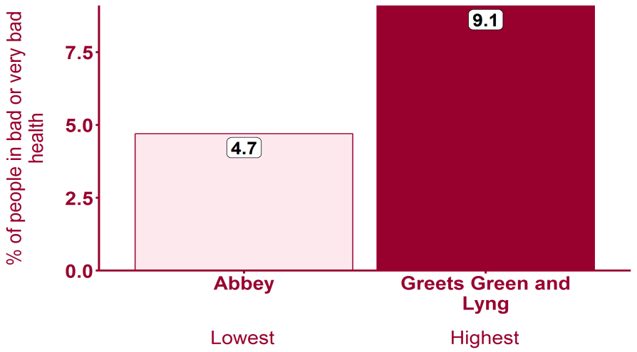
General Health - bad or very bad (2011)
Health Inequalities in Sandwell Version 1.3 Released March 2018

Slide 44
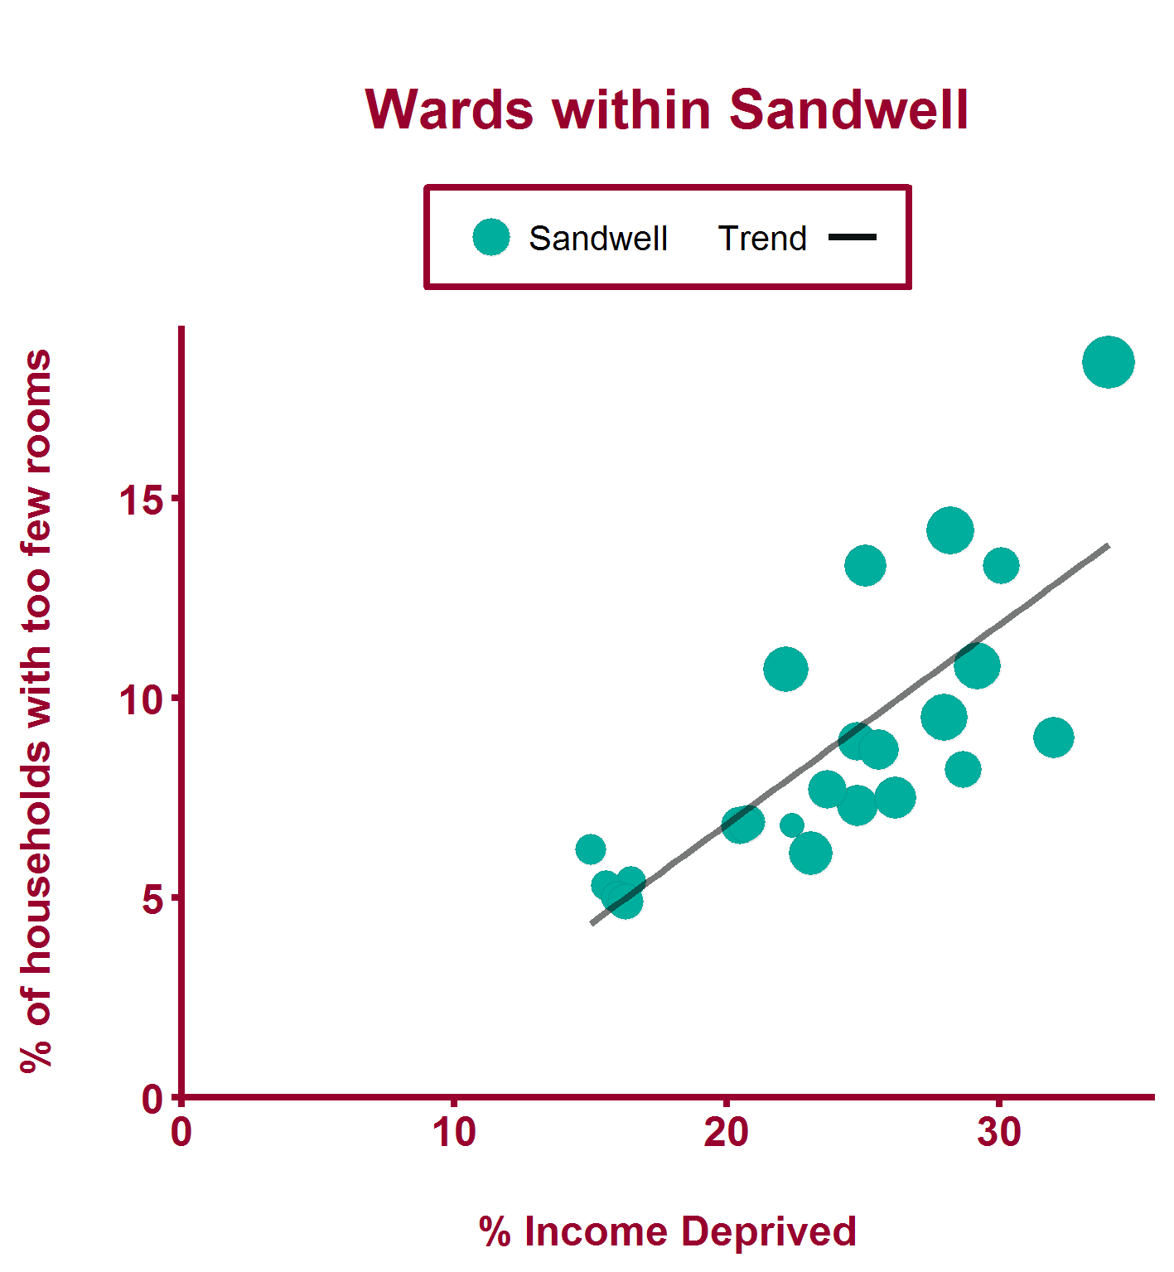
Overcrowding (2011)
Health Inequalities in Sandwell Version 1.3 Released March 2018

Slide 45
Overcrowding (2011)
Health Inequalities in Sandwell Version 1.3 Released March 2018

Slide 46
Feedback
We would like to hear your views on the Health Inequalities Briefings If you would like to let us know your thoughts then please complete our short questionnaire, available from: https://goo.gl/HKZoMt
Health Inequalities in Sandwell Version 1.3 Released March 2018

Slide 47
All icons
Icons made by Freepik, from www.flaticon.com
Health Inequalities in Sandwell Version 1.3 Released March 2018
Notes:
Freepik icons are free to use but you must credit them.

