Slide 1



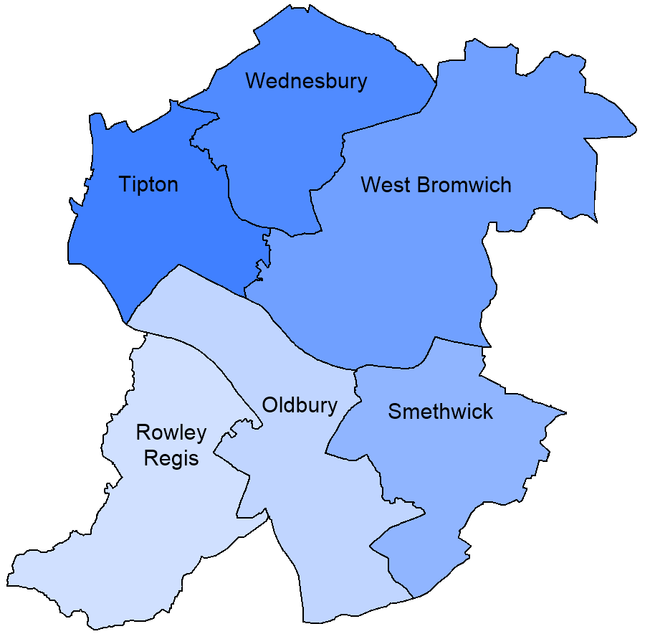
Men’s Mental Health Survey
Organisations
25 Respondents
August – October 2024
80% of respondents’ organisations are based in Sandwell
80% of respondents currently deliver mental health services / activities
96% of respondents would like to find out more / become involved with supporting Better Mental Health in Sandwell
Where is your organisation based?
Where does your organisation deliver services and provision?
Boroughwide
73%
14%
29%
28%
Other
20%
Carers
18%
23%
19%
43%
56%
Open to all
20%
Women
16%
Children & Young People
Which groups of the population do you serve?
24%
Men
20%
Un-employed
12%
LGBTQ+
27%
18%
28%
Parents/ Families
20%
Minority Ethnic Groups
16%
Older People
43%
29%
9%
14%

Slide 2

Men’s Mental Health Survey
Organisations
25 Respondents
August – October 2024
Do you have any intentions to hold more men’s sessions at your organisation?
What do you see as being the things that most impact men’s mental health and barriers to accessing support?
Feeling they can't talk to anyone about it
Job pressures
Relationships (inc. relationship breakdown)
Financial worries
Lack of friends / support
Stigma
Cultural perceptions of accessing mental health support
Unemployment / retirement
Lack of information
Lack of peer support
Language – not able to speak about it in their spoken language
Religious perceptions of accessing mental health support
Sexuality
Lack of information & services in spoken languages
Appropriate age provision & resources
Other
88%
80%
80%
76%
76%
76%
64%
64%
52%
52%
48%
48%
40%
40%
40%
12%
What would your organisation need to effectively support the men in your Community?

