Slide 1



Men’s Mental Health Survey
August – October 2024
What impacts most on men’s mental health?
Financial worries
Job pressures
Feeling they can’t talk to anyone about it
Relationships, relationship breakdown
Lack of friends/family support
Unemployment or retirement
Drinking
Drugs
Sexuality
68%
65%
59%
51%
50%
45%
40%
33%
22%
How much of a priority is your mental health?
How do you rate the level of support you currently have?
56%
Talking to friends
45%
Exercise by yourself
22%
Work
What things do you do that help you look after your mental health & wellbeing?
46%
Entertain-ment
26%
Turning to faith / prayer
19%
Go to the pub
4%
Nothing
47% of respondents would rate their current mental health as poor or very poor, or neither good nor poor
48%
Hobbies
29%
Go to the gym
22%
Volunt-eering
14%
Other
45%
Talking to family
25%
Exercise with others
17%
Community social groups

Slide 2
Men’s Mental Health Survey
Where would you go to get mental health support if you needed it?
August – October 2024
Only 10% of respondents think there is enough support for men’s mental health in Sandwell
Would you prefer to access support through your GP/medical setting or a community setting?
50%
1:1 counselling
60%
GP Practice
10%
Something else
42%
Men only peer support
Which would you find
the most helpful?
45%
Community Centre
Is there enough support for men's mental health in Sandwell?
23%
Group counselling
36%
Social opportunities
21%
Hospital/Medical Centre
20%
Leisure Centre
30%
Resilience tools
36%
Sporting activities
19%
Sports Club
32%
Wellbeing Café / Wellbeing space
35%
Peer support
18%
Somewhere else
Community activities are circled in yellow

Slide 3

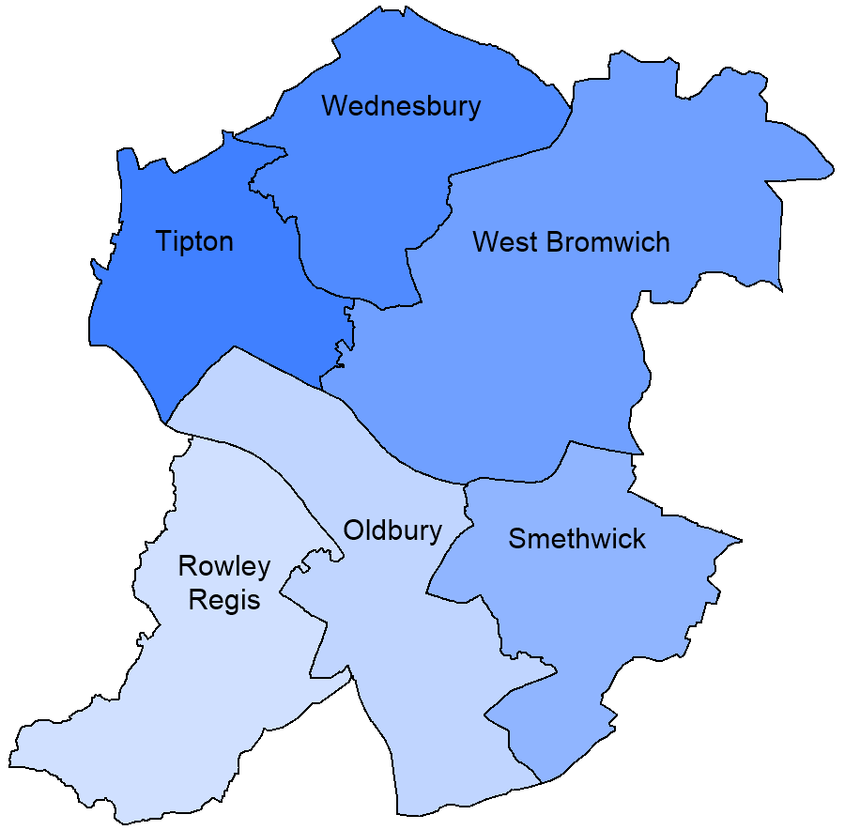








Men’s Mental Health Survey
Demographics
234 Respondents
45% of respondents said they have a physical or mental health condition or illness lasting or expecting to last 12 months or more
August – October 2024
What is your age?
Where do people live and work?
7%
9%
Don’t work
What type of physical or mental impairment?
12%
23%
12%
18%
Elsewhere in Sandwell
11%
3%
5%
53%
Mental Health
Outside Sandwell
26%
Longstanding illness or health condition
34%
13%
Which of these groups do you belong to?
29%
12%
22%
Physical disability
10%
13%
67% White
13% Asian or Asian British
5% Sikh
5% Prefer not to say
4% Black, Black British,
Caribbean or African
3% Other Ethnic Group
3% Mixed or Multiple
Ethnic Groups
9%
What is your sex?
8%
19%
Other
8%
Deafness or hearing impairment
100% of respondents said their gender is the same as the sex they were registered at birth
7%
Learning difficulty
3%
Blindness or visual disability

